Slide 1
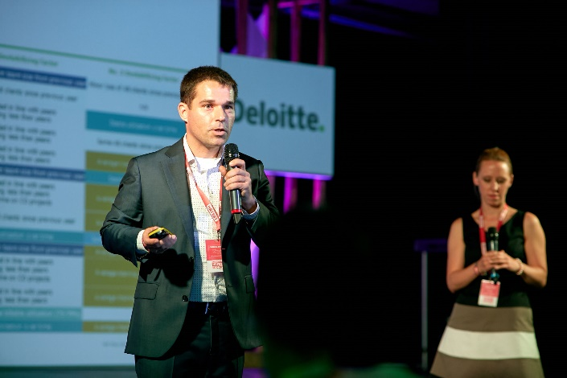
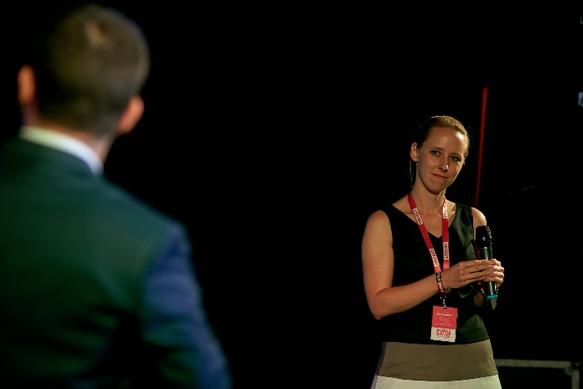
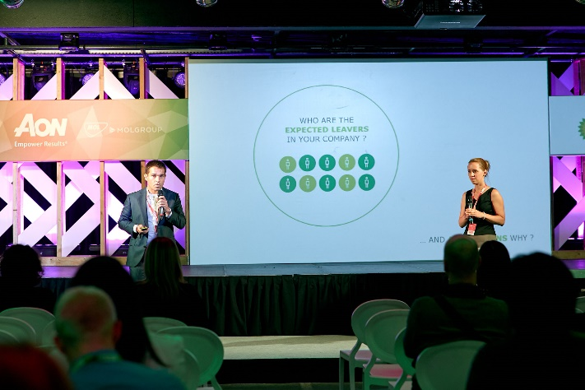
HR FEST in Budapest
The event with about 800 participants focused on the hot topics in the HR. Deloitte Czech Republic was represented by Pavel Šimák and Veronika Počerová who jointly presented the predictive analytics for employee churn.
Pavel was also asked to give an interview on the RTL channel, one of the most popular TV channels in Hungary
October 26th, 2017
For more information please contact Pavel Šimák

Slide 2

Now for the 10th time, SheXO is back!

Slide 3


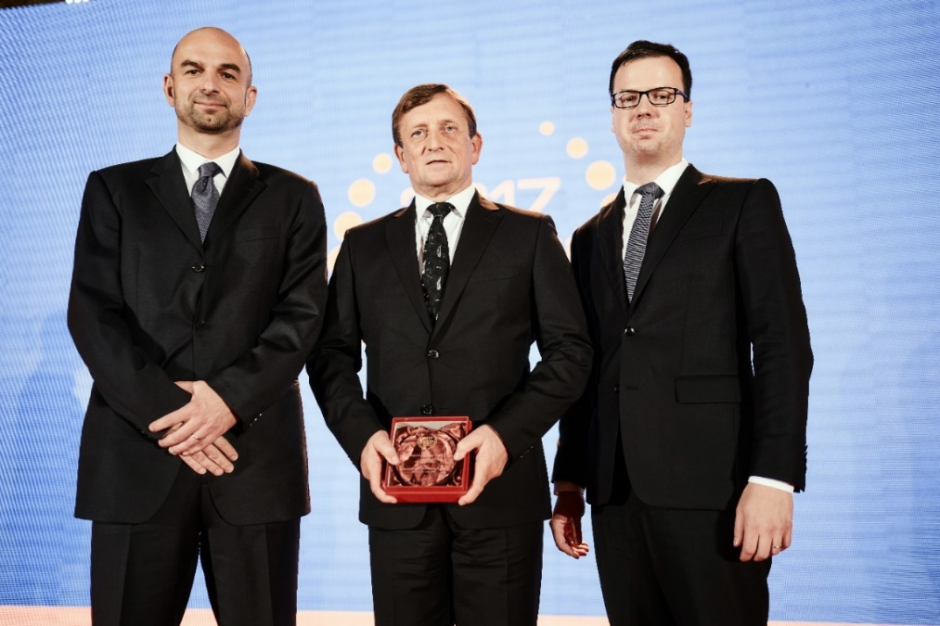
Medal for Deloite Legal
Ambruz & Dark Deloitte Legal has received the Czech Law Firm of The Year 2017 award in the category of Labour Law.
The lawyers also successfully defended last year’s ranking among
Highly Recommended Law Offices in the area of Tax Law.
And it also became a Recommended Law Office
in the following categories:
Corporate Law
Development and Real Estate Projects
Mergers and Acquisitions
Intellectual Property
For more information please contact Dominik Hrodek

Slide 4
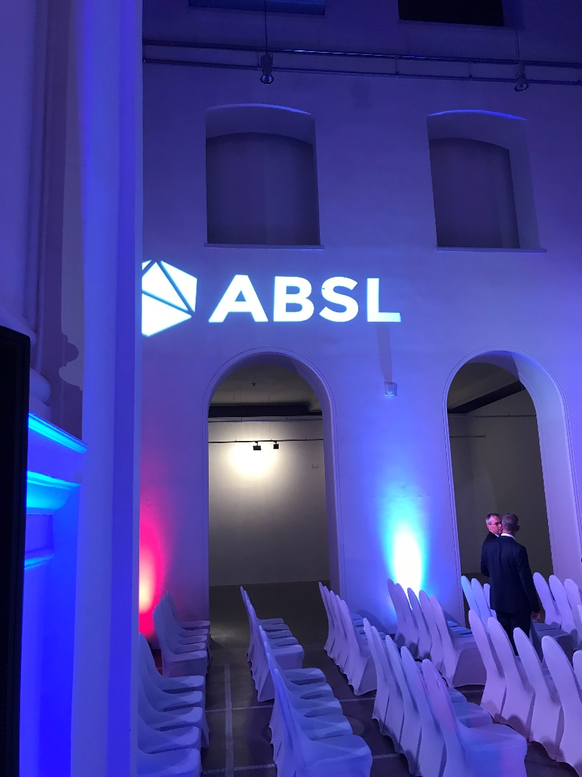
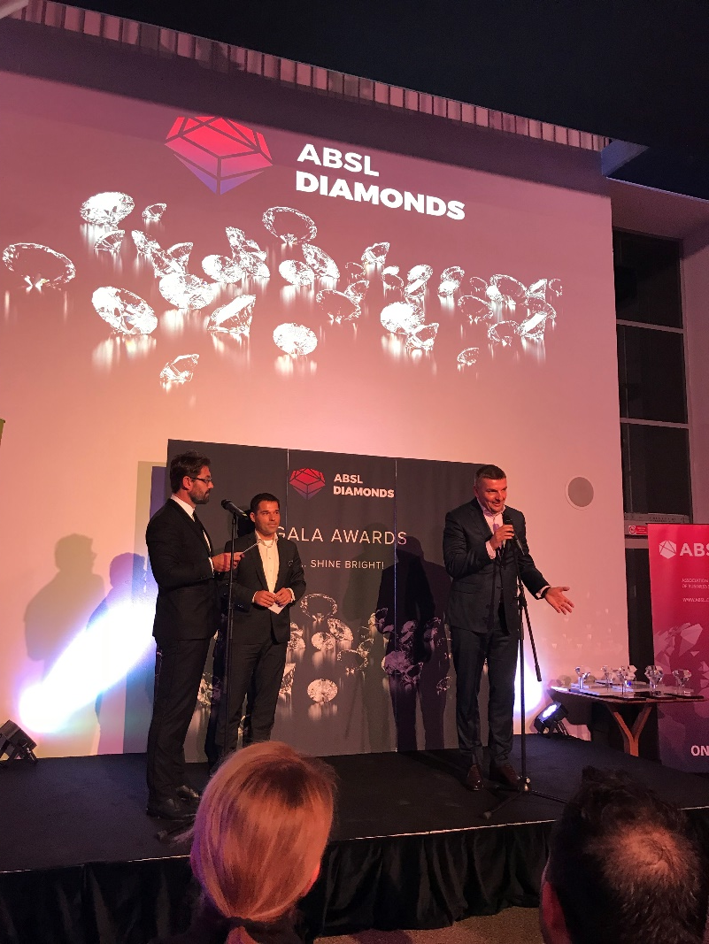
ABSL CONFERENCE
On October 19th, we participated in the ABSL Conference as a Platinum partner, with several speakers from Deloitte covering different subjects, and Pavel Šimák and Milan Kulhánek awarding prizes at the event.
Topics Covered
Talent management and retention strategies to keep winning.
Robotics and automation - not just a luxury but a MUST-HAVE.
Future workplaces and driving your business with your property strategies.
The Business services roadmap for 2030 and beyond.
Education for GBS - partnerships to drive and deliver the future talent we nee
For more information contact
Pavel Šimák or Milan Kulhánek

Slide 5
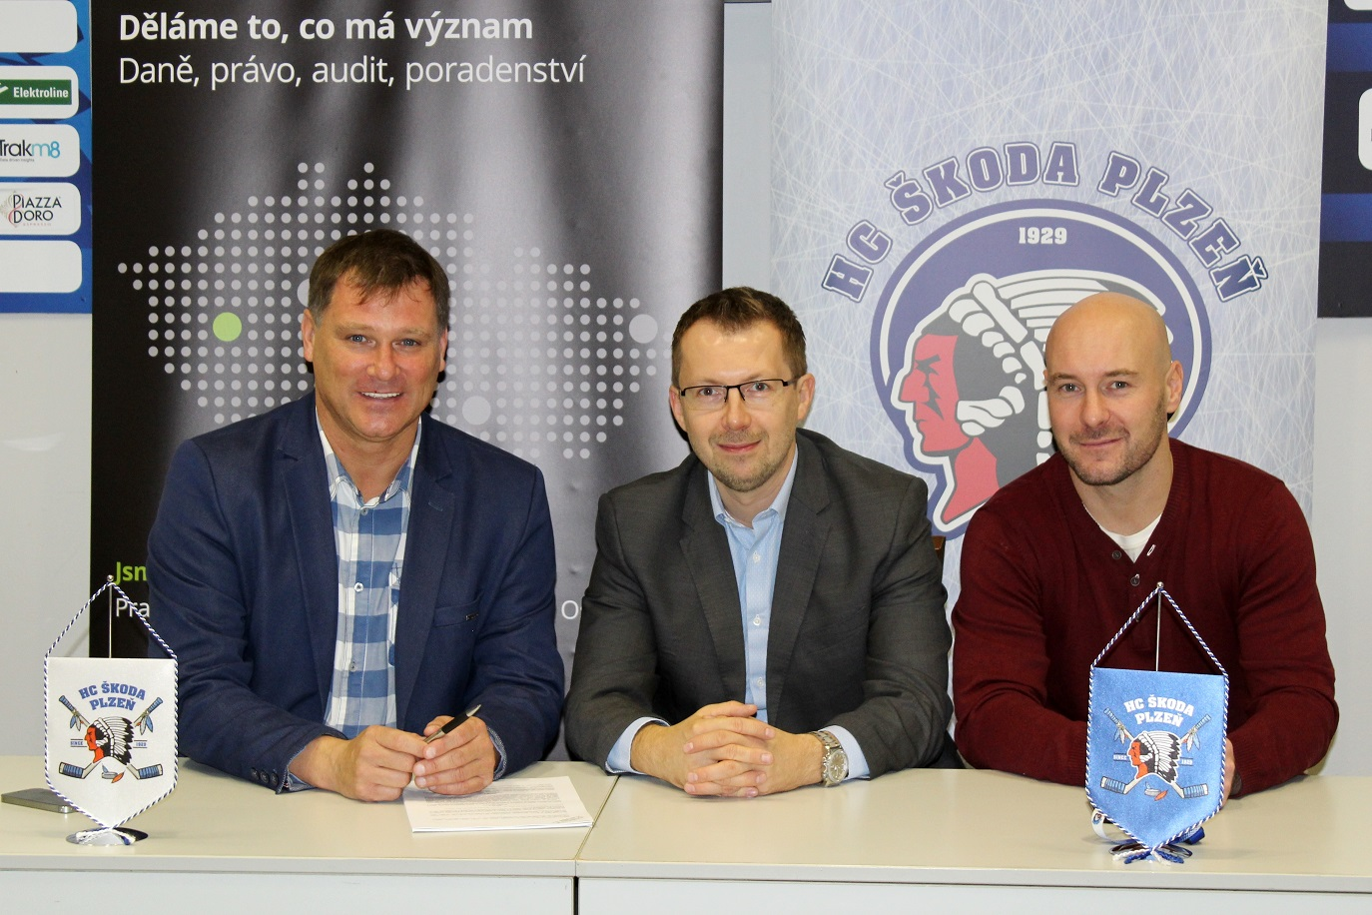
Deloitte becomes a business Partner of HC Škoda Plzeň
  The Škoda Plzeň Hockey Club has revealed another significant partner for the ongoing season
  Tax and legal advisory services to be newly provided by Deloitte.
For more information please contact Antonín Weber

Slide 6

Business Breakfast
Planning, Budgeting and Forecasting in digital a world:
TOMORROW WILL NOT WAIT!
October 31st, 2017
Client Suite
Marek Kouril and his Finance Transformation team held a breakfast for CFOs and other heads of finance departments. In this forum, they discussed the findings of a survey conducted by the team in September and current trends in planning, budgeting and forecasting.

Slide 7
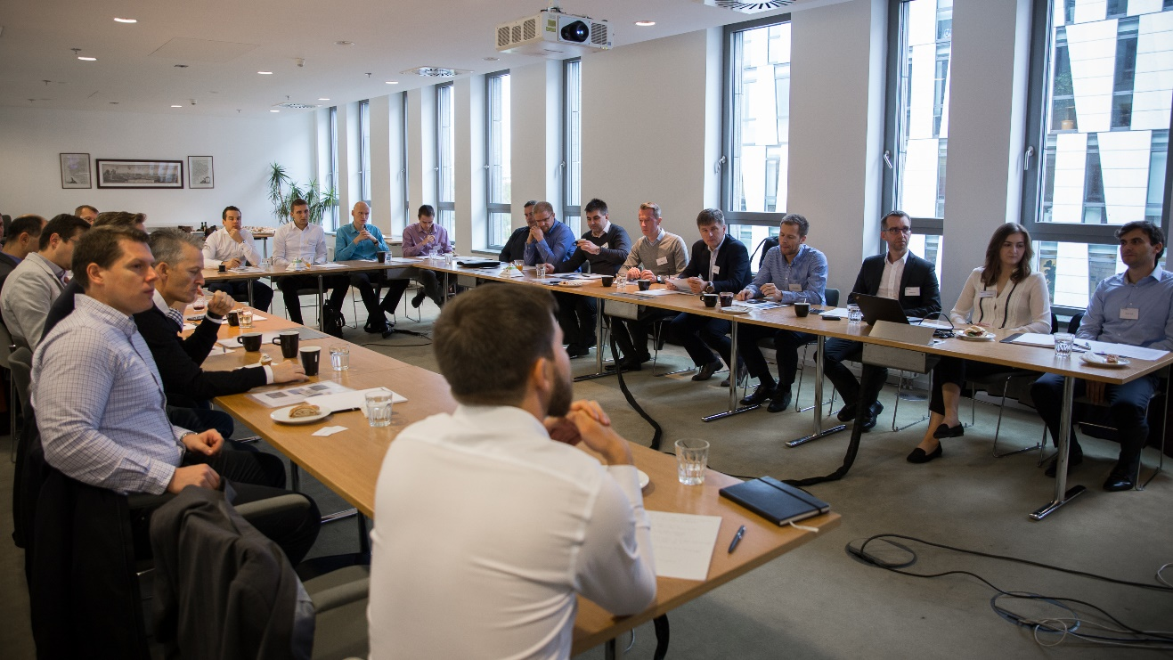
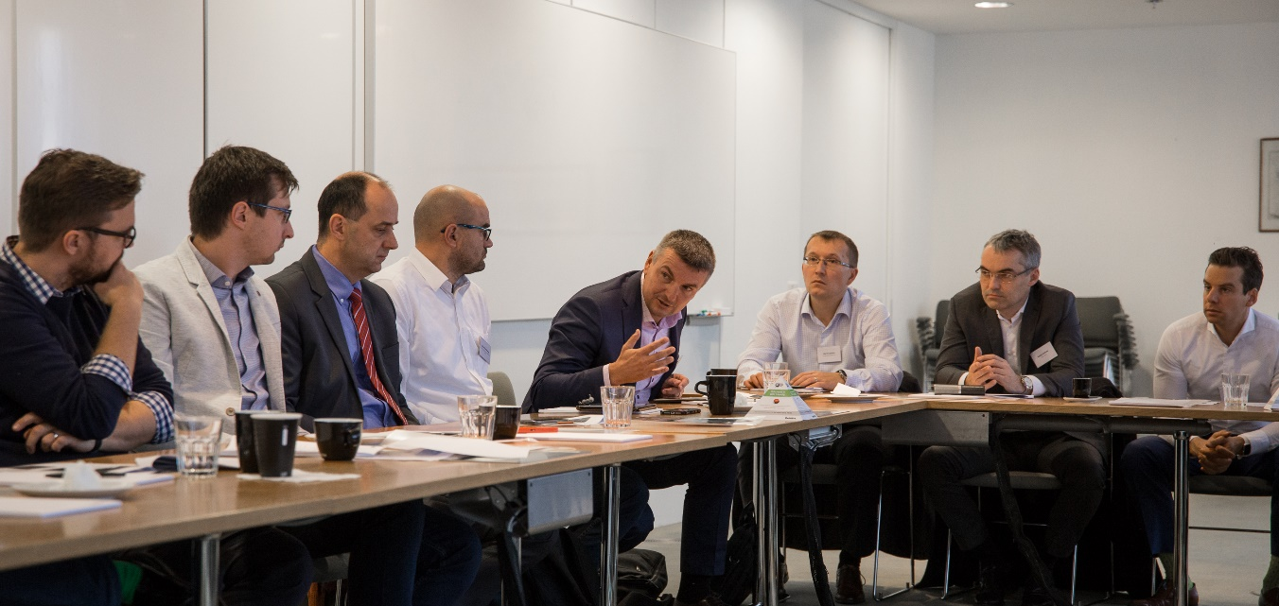
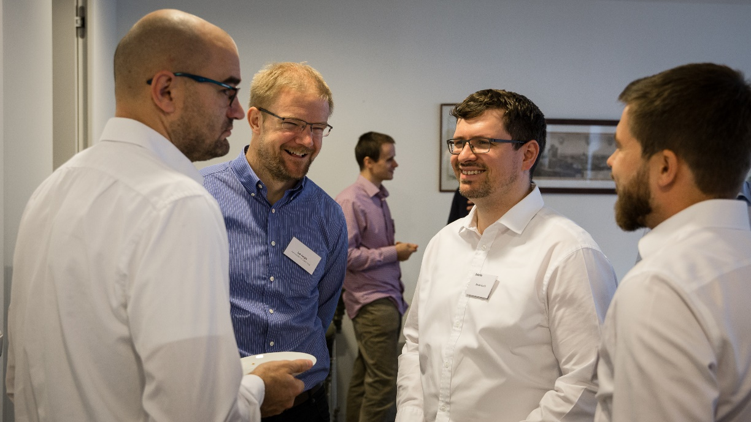
Business Breakfast
Planning, Budgeting and Forecasting in a digital world:
TOMORROW WILL NOT WAIT!
October 31st, 2017
Client Suite
“Excellent! Thank you for organising this event!”
“Thank you! Very nicely organised. Great discussion.”
“This topic is very relevant today and, as the findings of the survey show, also needed.
“Nicely summed up key issues of the topic.”

Slide 8

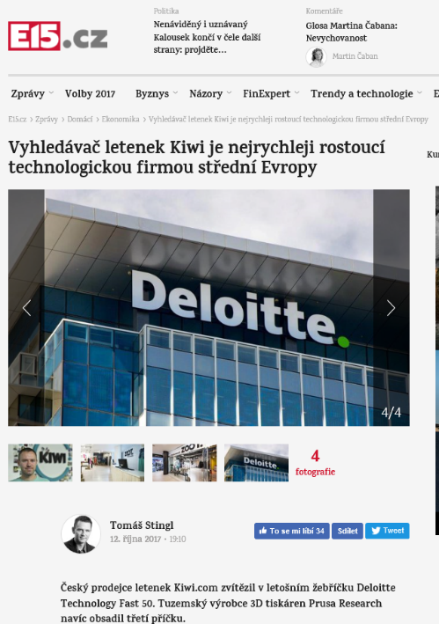
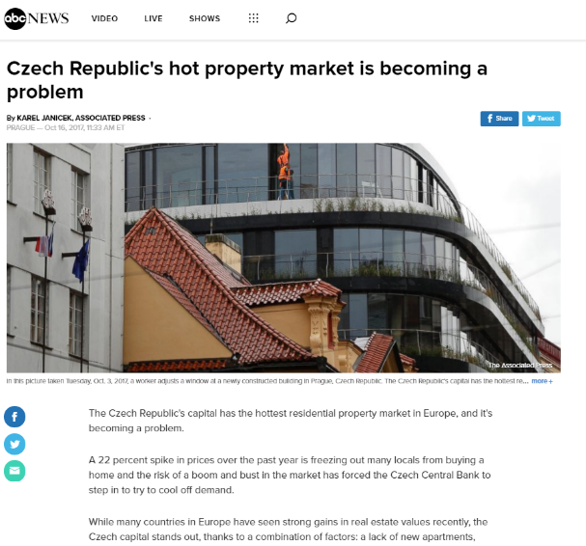
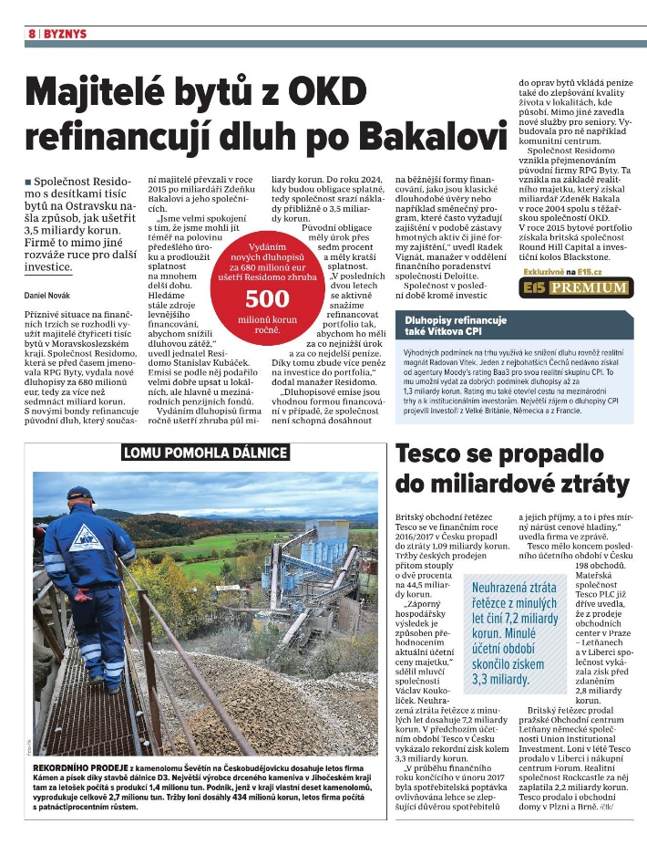
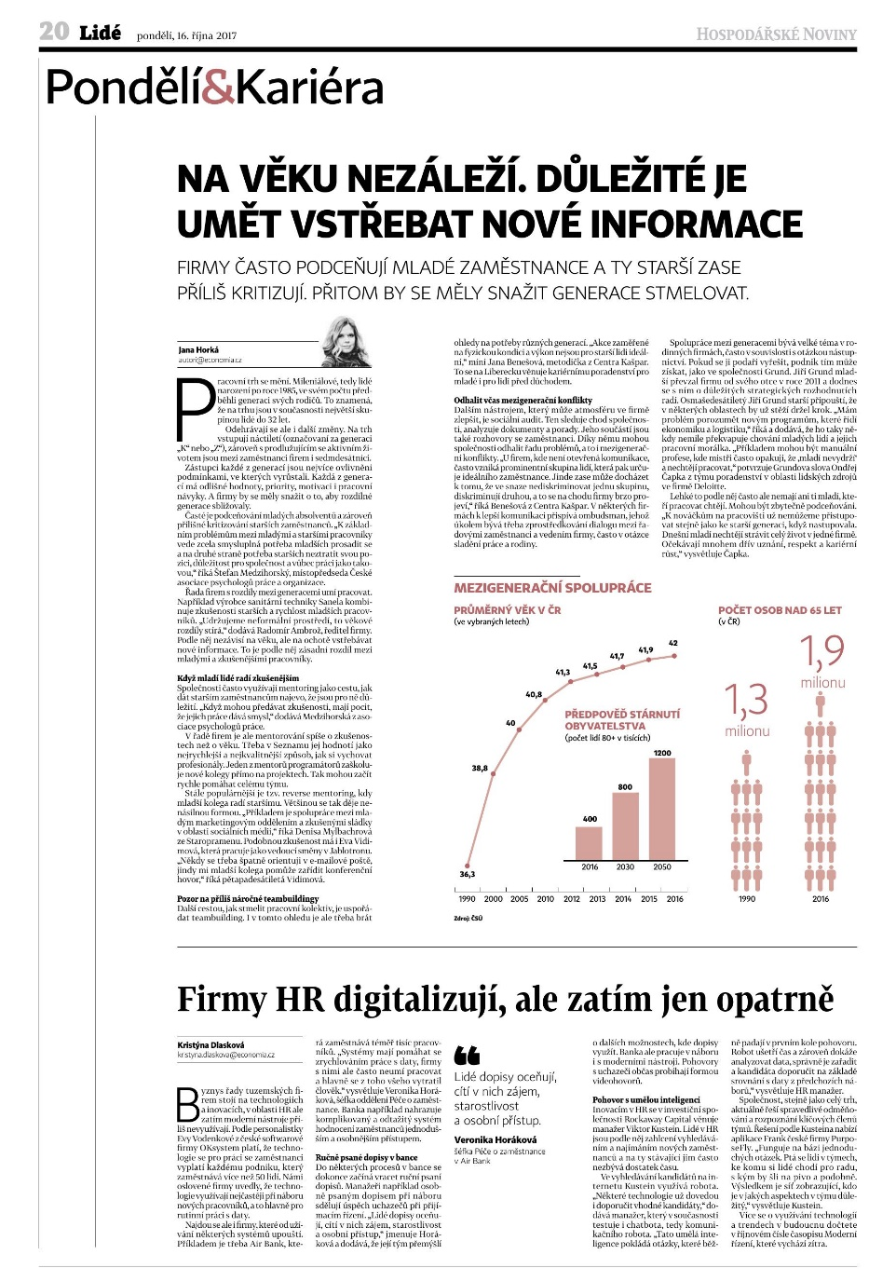
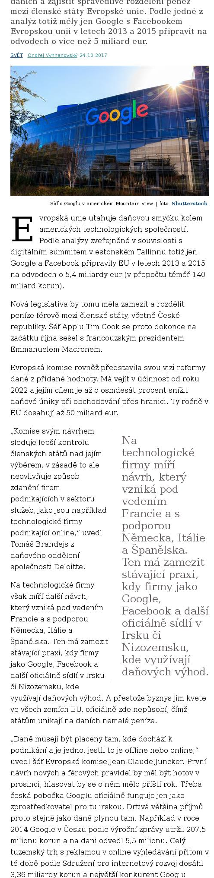
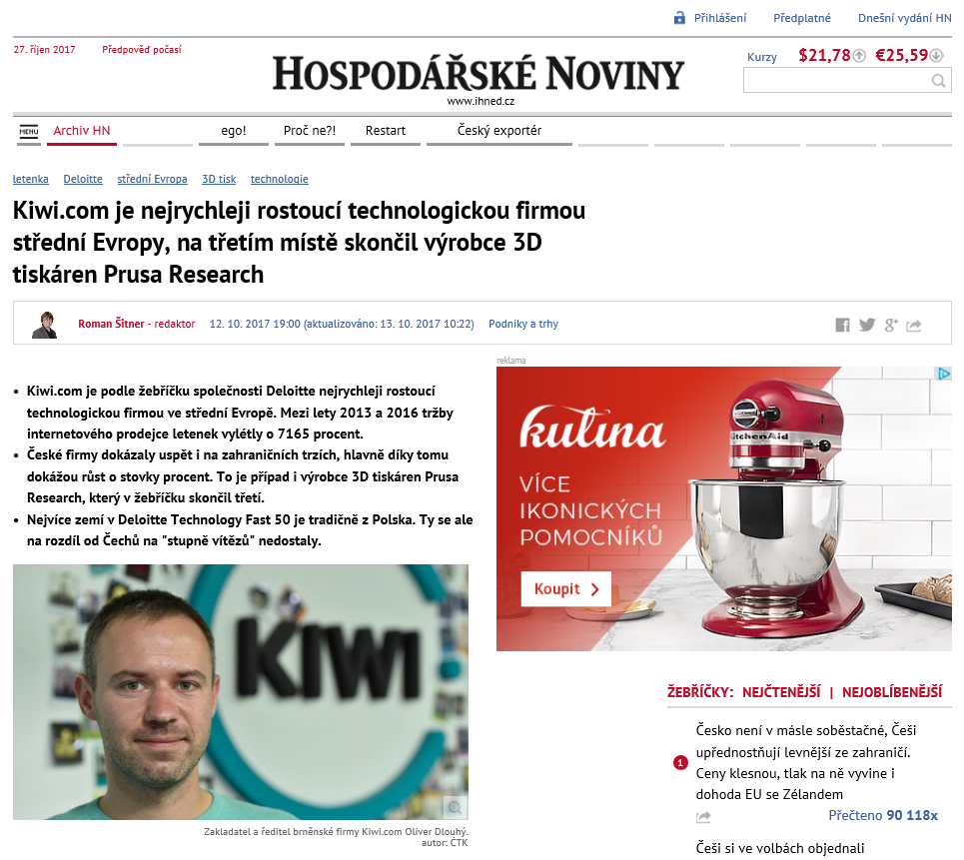
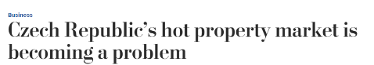
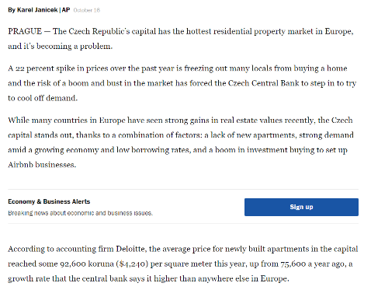

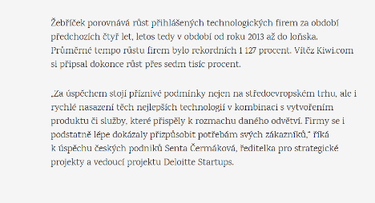
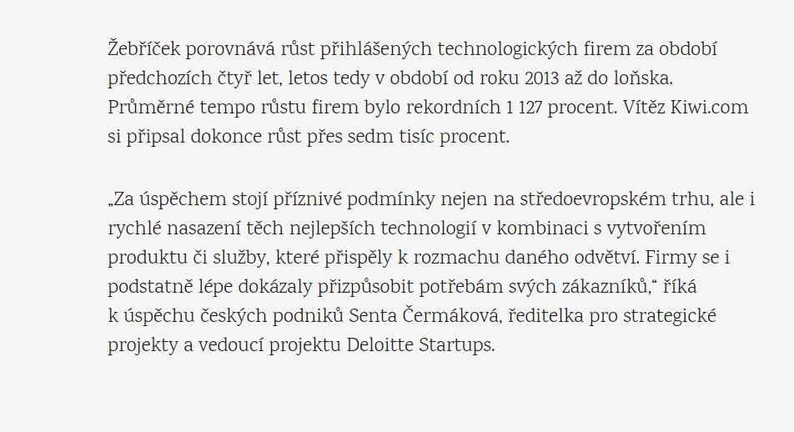
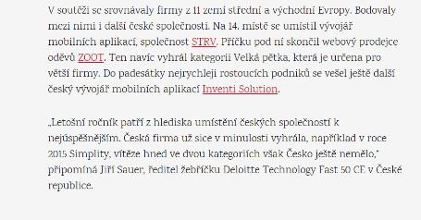
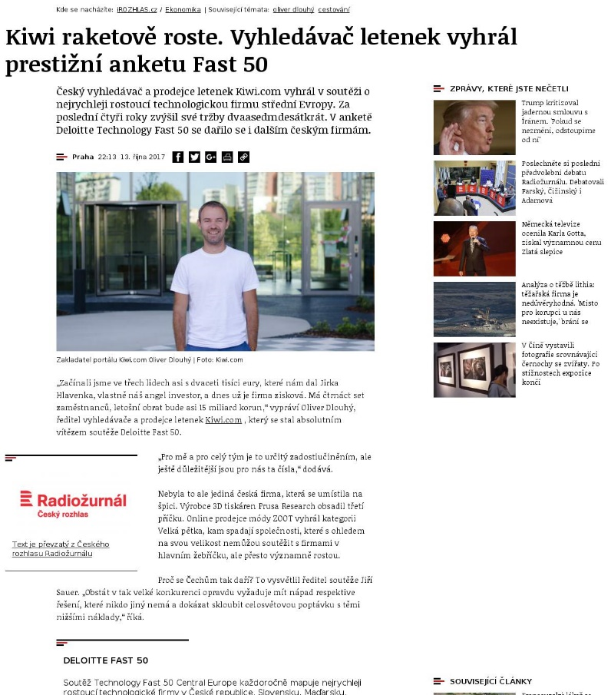
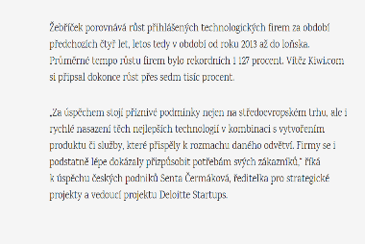
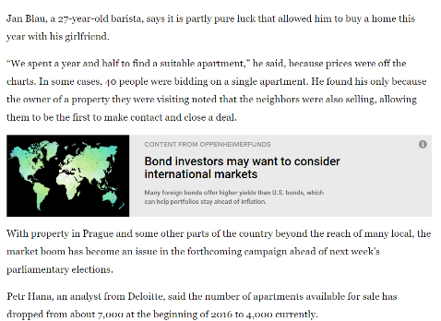
Deloitte in the media
346x in October only.
Do you also have anything to say?
Contact PR team: mmalysa@deloittece.com, achocholata@deloittece.com.

Slide 9
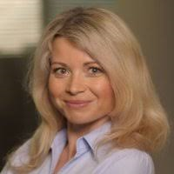
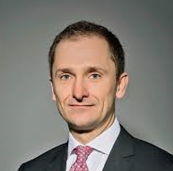
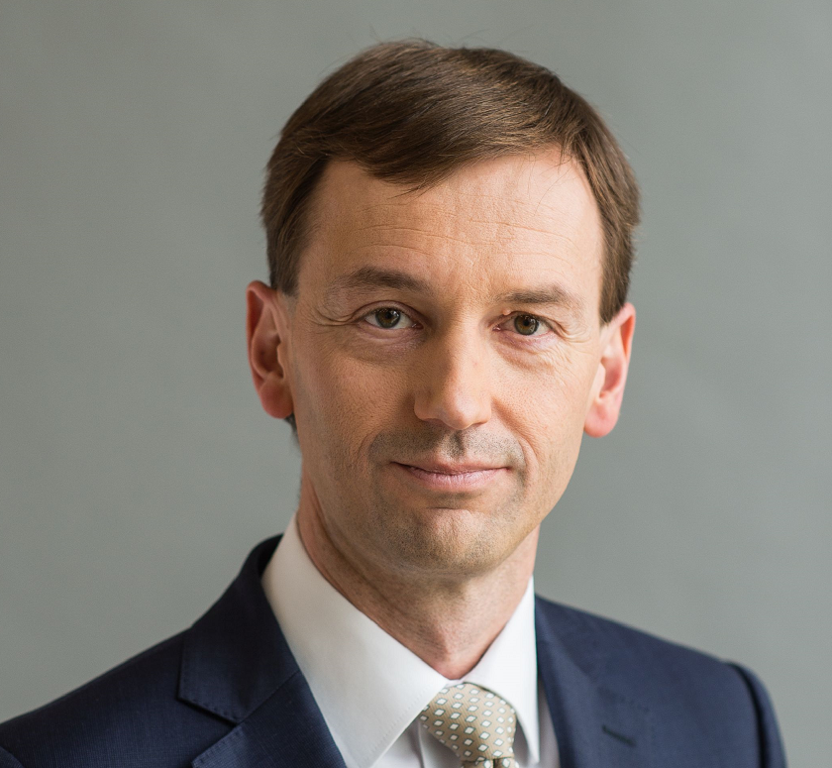
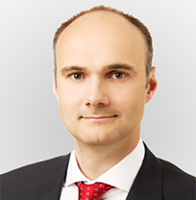
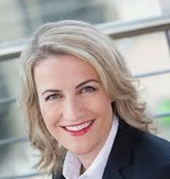
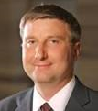
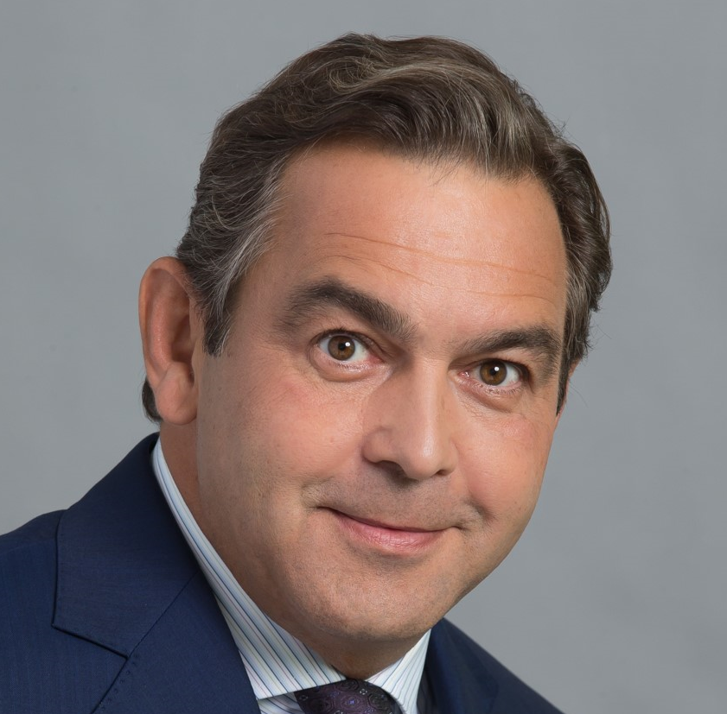
CXO Talks
“CXO Talks” Event
FS Audit / Advisory of the future
On 16-17 October, Deloitte hosted “CXO Talks”, a panel moderated by Diana Rádl Rogerová with seven board members of leading Czech banks – CEOs, CFOs, COOs and a Chief Retail Officer.
The session provided senior FSI professionals from across DCE with valuable insights into the priorities and challenges of CXOs and in how they perceive Deloitte as an Audit and Advisory firm.
The learnings from the event will be reflected in selective adjustments to our services delivery model.
The overall feedback on Deloitte was positive, clearly showing that we have been moving into the right direction with our strategy and offerings:
K. Soukeník, COO Sberbank: “In FS Audit, there are only 2 relevant firms in CZ,
Deloitte being one of them; Deloitte has the broadest skills coverage among Big 4“
L. Tešić, CFO UniCredit: ”Up to 30% of CFO time goes to regulatory – regulatory competence of the advisor is key”
T. Spurný, CEO MONETA: “Capability of combining technology with customer experience and data is key for advisors, plus the ability to implement.”
For more information please contact Diana Rádl Rogerová or Petr Brich

Slide 10
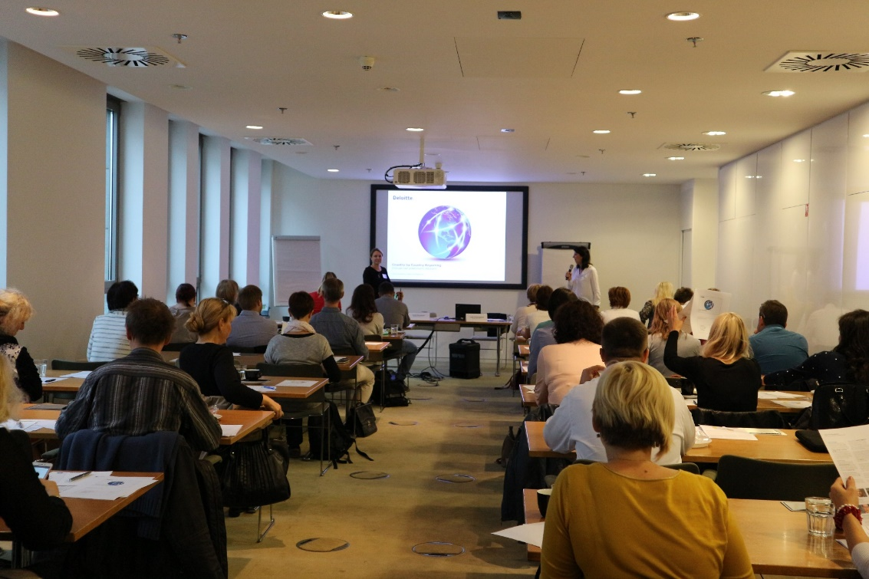
Country by Country Reporting
Country by Country Reporting training took place on Thursday, 19 October 2017. It was designed to pinpoint the obligations of all Czech entities that are part of multinational groups with a turnover exceeding EUR 750 million.
The first obligation involves filing a notification (“ohlášení”) to the Specialised Tax Office by 31 October 2017.
For more information please contact Gabriela Justova

Slide 11

Open Positions at Deloitte
Deloitte CE
  Solution Architect
Deloitte CE
  Junior Consultant Independence
FAS
  Associate (Corporate Finance)
FAS
  Associate (Transaction Services)
Tax
  Senior Consultant (FSI)
Internal Services
  HR Administrator
Do you know that you are eligible to receive a special STAR awards bonus if you recommend a suitable candidate who
is then hired?
For more information please contact our recruitment team

Slide 12
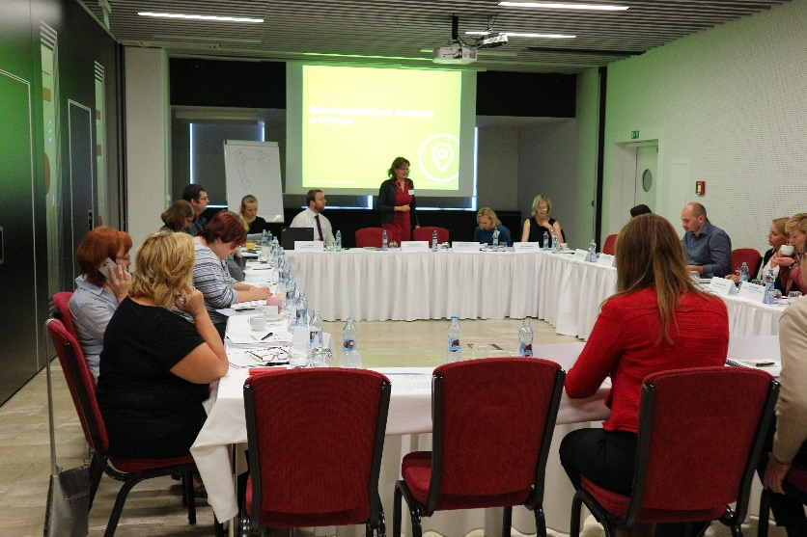
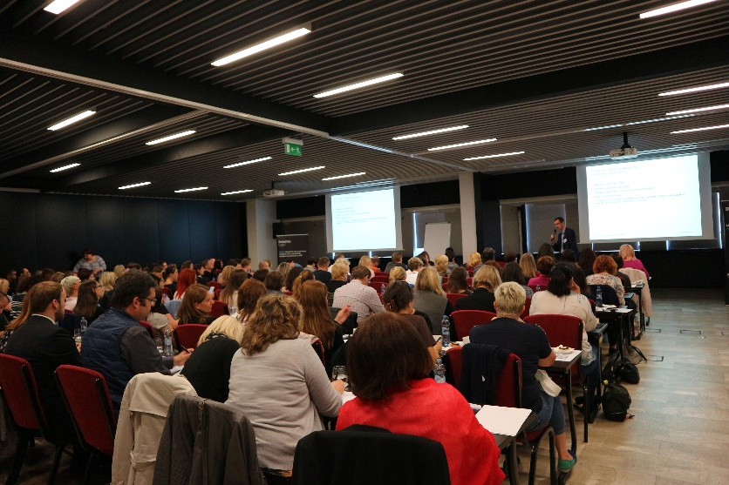
Another successfull VAT seminar
This year’s event saw the participation of more than 100 clients from among various economic sectors. It took place on 16 October 2017 in Hotel Grandior, Prague 1,
During the afternoon workshops, our VAT team assisted the seminar participants with solving specific issues of their respective economic sectors. The individual approach, advice and other recommendations were highly appreciated by the participants.
For more information please reach out to Erika Sanderova

Slide 13

Experience Management Consulting
October 5th, 2017
Nile House
Students became Deloitte consultants for a day!
With guidance from mentors from the Finance Transformation team, students helped their client with strategic changes in production, process optimization and they proposed an implementation plan during a one day workshop.

Slide 14
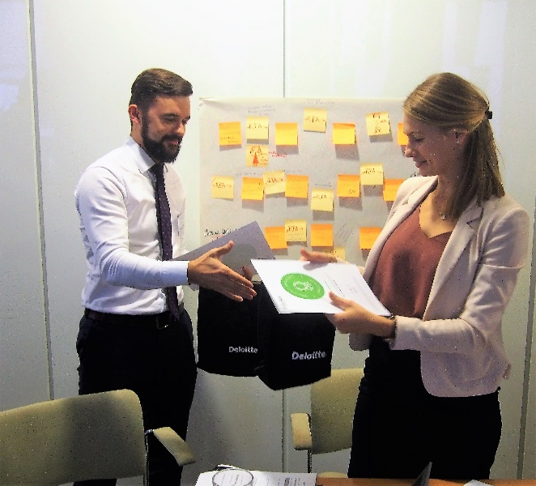
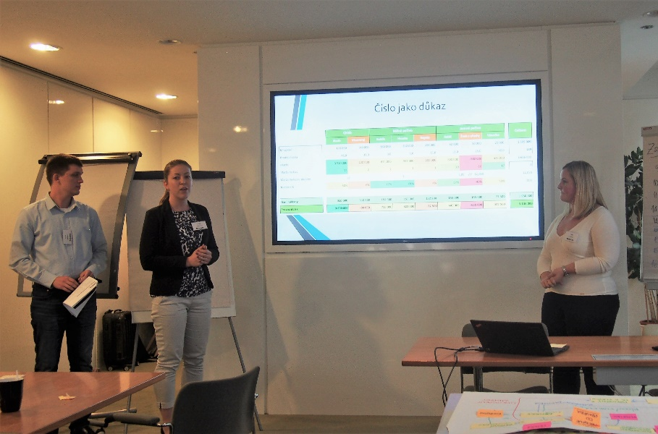
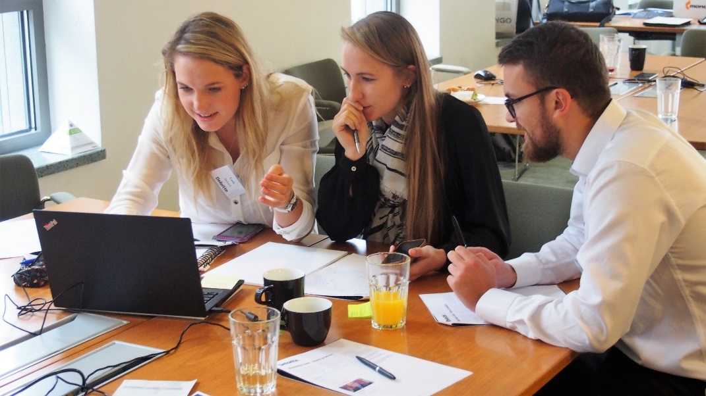
Experience Management Consulting
October 5th, 2017
Nile House
“My friend recommended this workshop to me and I will definitely do the same. Thank you!“
“Amazing experience. I had theoretical knowledge of consulting but today I had a chance to get all day long hands-on experience. It was brilliant!“
“I am pleasantly surprised by Consulting.
I think I will choose Consulting as my minor now. Great experience.“

Slide 15

Technology Fast 50 CE
Results
A Czech firm won in the main category !
#1
Kiwi.com
The fastest growing technology company in Central Europe in 2017

Slide 16
Technology Fast 50 CE Results
Czech companies scored in 2017!
Fast 50
Category
Big 5
Category
Raising Stars
Category
The most disruptive innovation
#1 Kiwi.com
#3
Prusa Research
#1
ZOOT
#7
Pilulka Distribuce
IDEA RS
among 10 finalists
#14
STRV
#15
ZOOT
#37
INVENTI Solution
For more information visit www.deloitte.cz/fast50

Slide 17
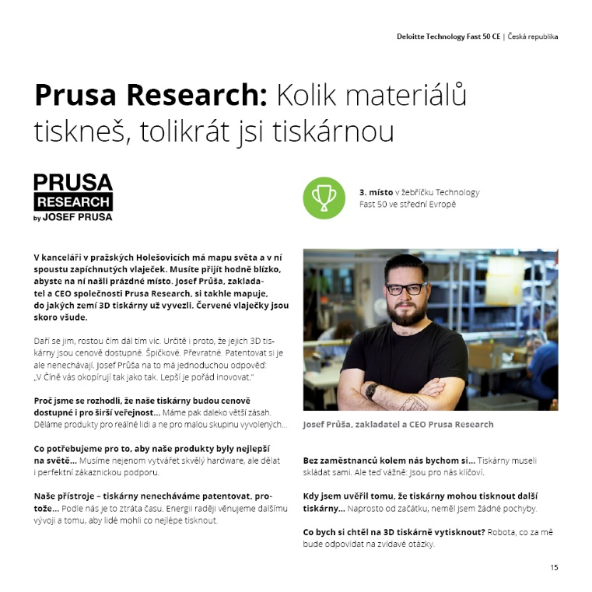

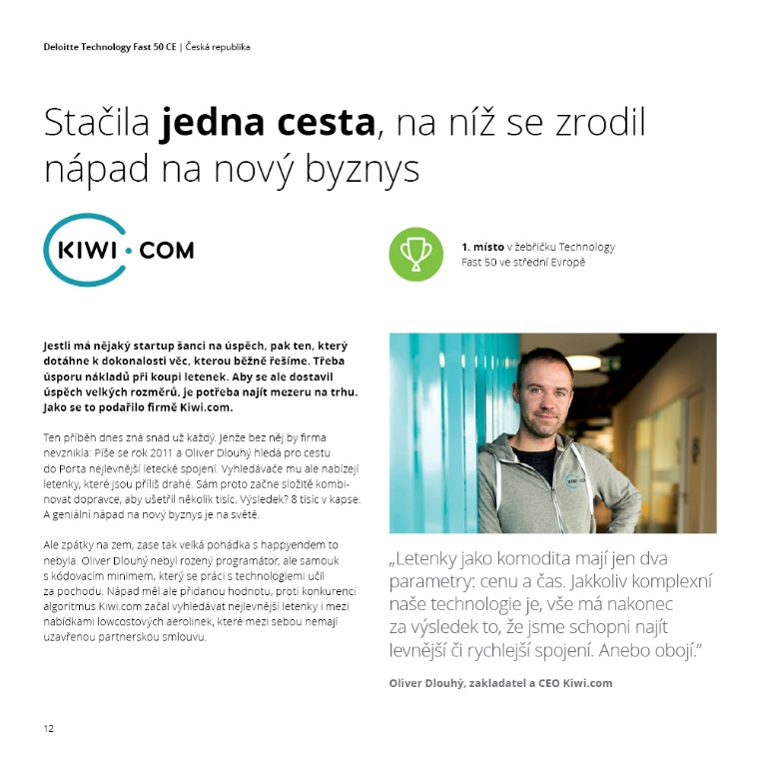
Technology Fast 50 CE:
Speciální česká brožura!
11 příběhů a rozhovorů
Poznejte nejrychleji rostoucí technologické firmy
Brožuru připravil Content tým v oddělení C&M
Více informací poskytne Klára Vyskočilová

Slide 18
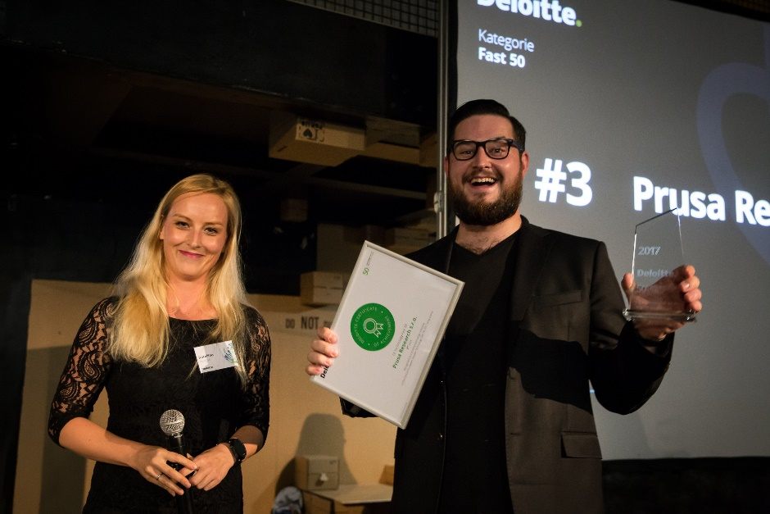
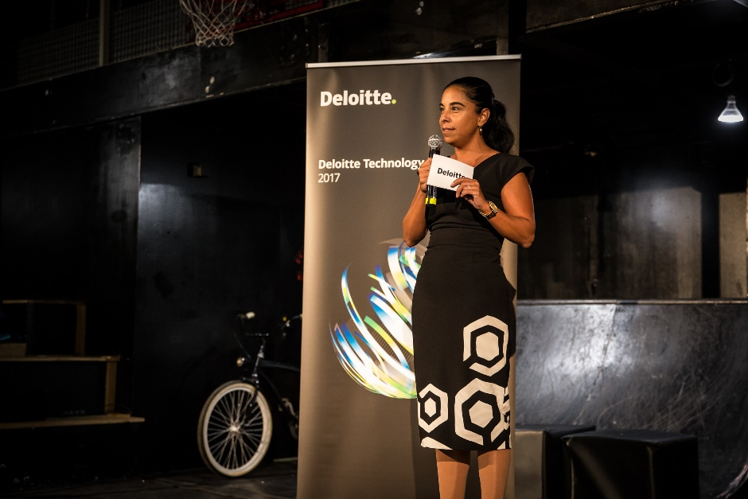
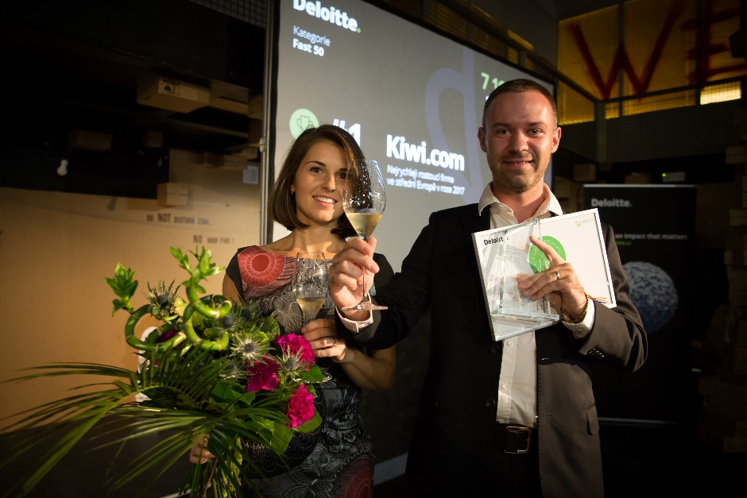
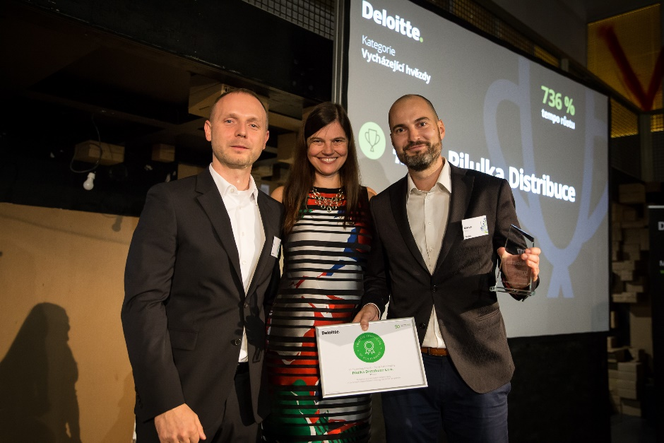
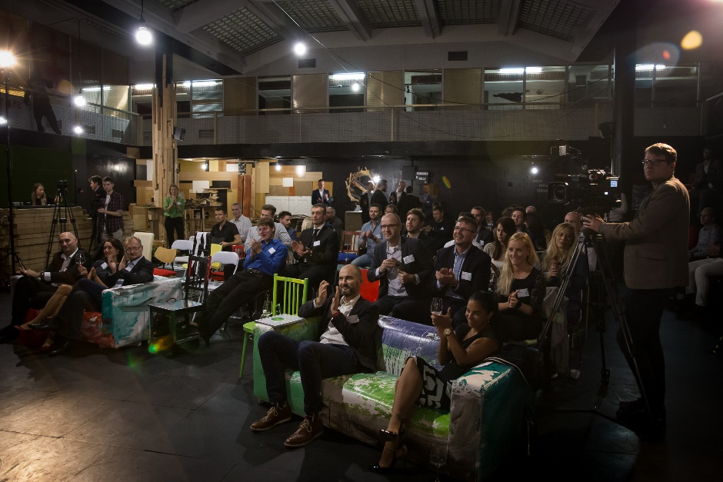
Technology Fast 50 CE
Prague’s Ceremony

Slide 19






Czech team part of Deloitte Global Business Services Eminence Group
Practice: Global Business Services
Central Eminence Team
Tasks of the Central Team
Discuss on current challenges, improving Deloitte marketing / launch initiatives and sharing of eminence plans in the GBS area across markets
Align on eminence activities to avoid overlapping and working together as one global firm
Czech team led by Pavel Šimák became a core member of the Deloitte Global GBS Eminence Team, composed of 6 leading countries
Our clients expect us to know the GBS and SSC market
For more information please reach out to Pavel Šimák

Slide 20

Recent New Wins
Sokolovská uhelná, a.s.
Optimization of energies production and trading
395,000 EUR
+ success fee
Consulting
Martin Čermák, Miroslav Cink

Slide 21
Recent New Wins
ZF Engineering Plzeň s.r.o.
Konica Minolta Business Solutions Czech Republic
140,000 EUR
EUR 130,000
Tax
A. Weber, L. Hanáček, J. Wiederhold, O. Svejkovsky
Tax
L. Hanáček, P. Chytilová,
G. Jansová

Slide 22
Recent New Wins
ELT Management Company
Czech Republic s.r.o.
ELT Management Company
Slovakia s.r.o.
EUR 206,858
200,000 EUR
Legal & Consulting
Legal and Consulting teams led by T. Babáček
Legal & Consulting
Legal and Consulting teams led by T. Babáček

Slide 23

Work opportunity for Senior Consultants
We are looking for a Deloitte Private project coordinator
Currently as a 60% part-time position, full-time going forward
Join us in supporting family and private clients by becoming a coordinator
of a key initiative
What will be your tasks?
  Setting up the process with the management team, coordinating
  the whole project
  Overseeing Key Account Managers for our Deloitte Private clients
  Working with different internal systems, e.g. O2E
  Communicating and working closely with partners across Deloitte
What will you not do without?
A very good grasp of English – experience in project management –
knowledge of Deloitte’s environment – assertiveness – proactive approach
For more information contact vmuckova@deloittece.com

Slide 24
