Slide 1
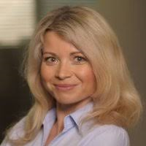
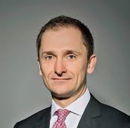
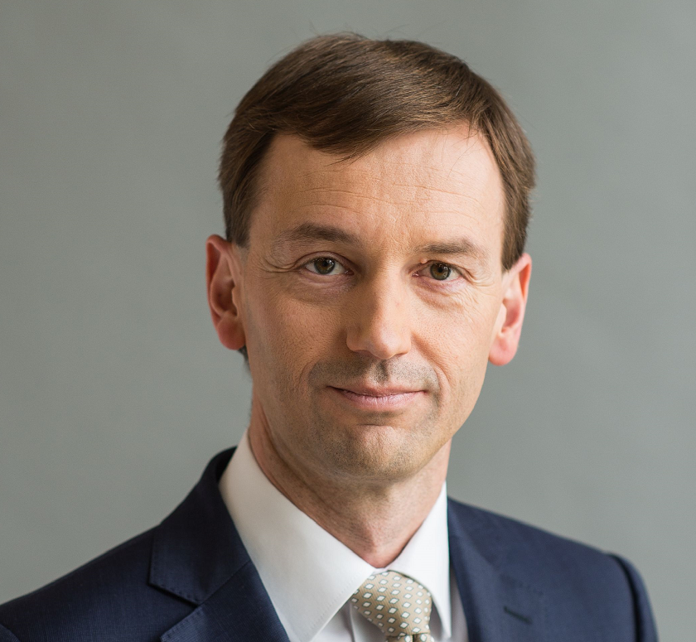
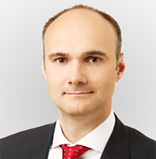
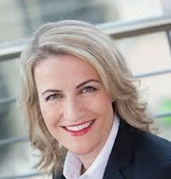
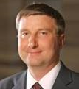
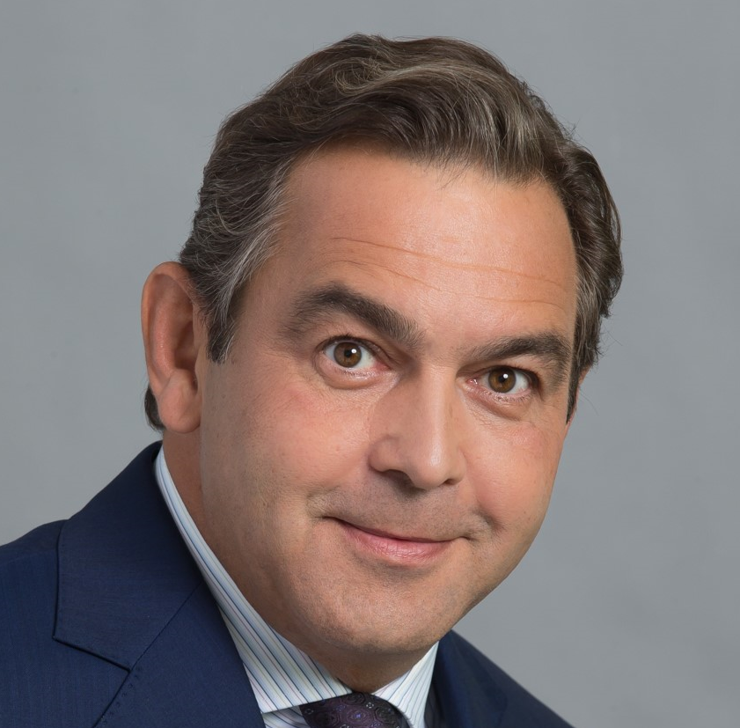
CXO Talks
“CXO Talks” Event
FS Audit / Advisory of the future
On 16-17 October, Deloitte hosted “CXO Talks”, a panel moderated by Diana Rádl Rogerová with seven board members of leading Czech banks – CEOs, CFOs, COOs and a Chief Retail Officer.
The session provided senior FSI professionals from across DCE with valuable insights into the priorities and challenges of CXOs and in how they perceive Deloitte as an Audit and Advisory firm.
The learnings from the event will be reflected in selective adjustments to our services delivery model.
The overall feedback on Deloitte was positive, clearly showing that we have been moving into the right direction with our strategy and offerings:
K. Soukeník, COO Sberbank: “In FS Audit, there are only 2 relevant firms in CZ,
Deloitte being one of them; Deloitte has the broadest skills coverage among Big 4“
L. Tešić, CFO UniCredit: ”Up to 30% of CFO time goes to regulatory – regulatory competence of the advisor is key”
T. Spurný, CEO MONETA: “Capability of combining technology with customer experience and data is key for advisors, plus the ability to implement.”
For more information please contact Diana Rádl Rogerová or Petr Brich

Slide 2
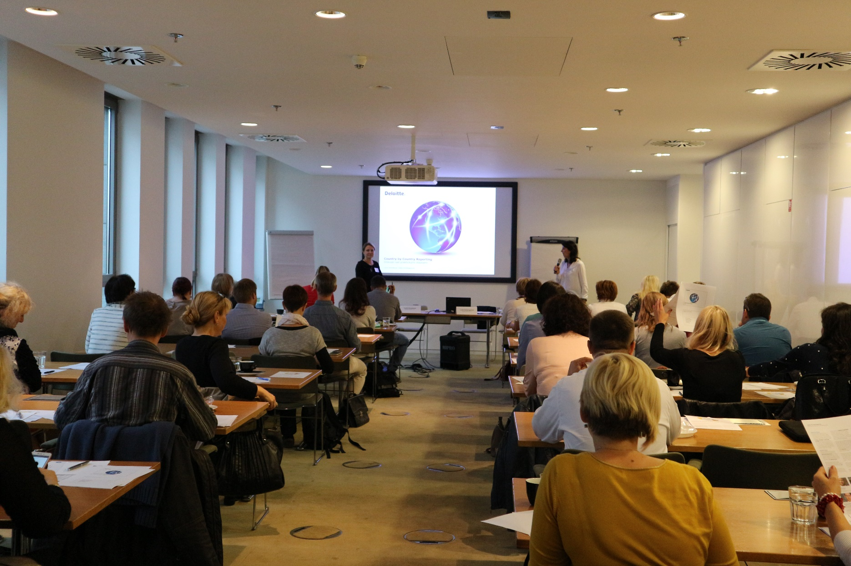
Country by Country Reporting
Country by Country Reporting training took place on Thursday, 19 October 2017. It was designed to pinpoint the obligations of all Czech entities that are part of multinational groups with a turnover exceeding EUR 750 million.
The first obligation involves filing a notification (“ohlášení”) to the Specialised Tax Office by 31 October 2017.
For more information please contact Gabriela Justova

Slide 3

Open Positions at Deloitte
Deloitte CE
  Solution Architect
Deloitte CE
  Junior Consultant Independence
FAS
  Associate (Corporate Finance)
FAS
  Associate (Transaction Services)
Tax
  Senior Consultant (FSI)
Internal Services
  HR Administrator
Do you know that you are eligible to receive a special STAR awards bonus if you recommend a suitable candidate who
is then hired?
For more information please contact our recruitment team

Slide 4
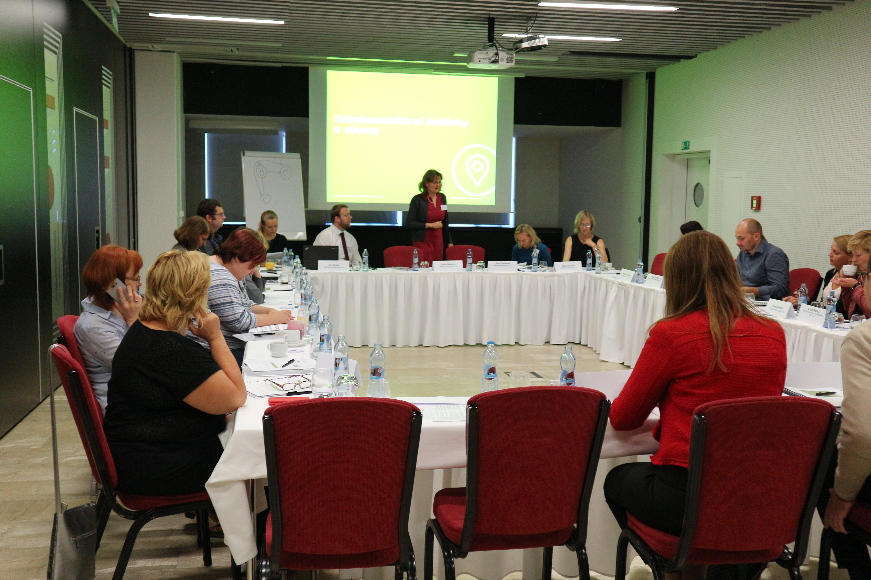
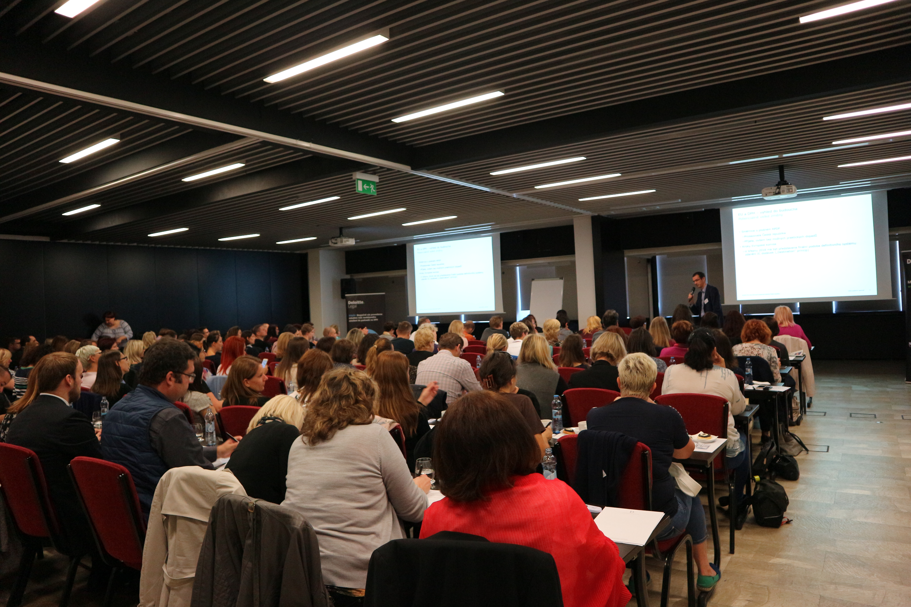
Another successfull VAT seminar
This year’s event saw the participation of more than 100 clients from among various economic sectors. It took place on 16 October 2017 in Hotel Grandior, Prague 1,
During the afternoon workshops, our VAT team assisted the seminar participants with solving specific issues of their respective economic sectors. The individual approach, advice and other recommendations were highly appreciated by the participants.
For more information please reach out to Erika Sanderova

Slide 5

Experience Management Consulting
October 5th, 2017
Nile House
Students became Deloitte consultants for a day!
With guidance from mentors from the Finance Transformation team, students helped their client with strategic changes in production, process optimization and they proposed an implementation plan during a one day workshop.

Slide 6
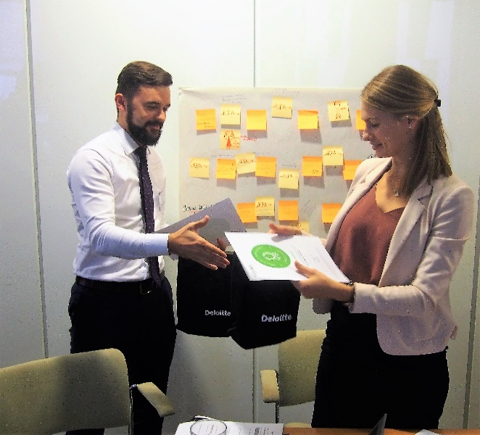
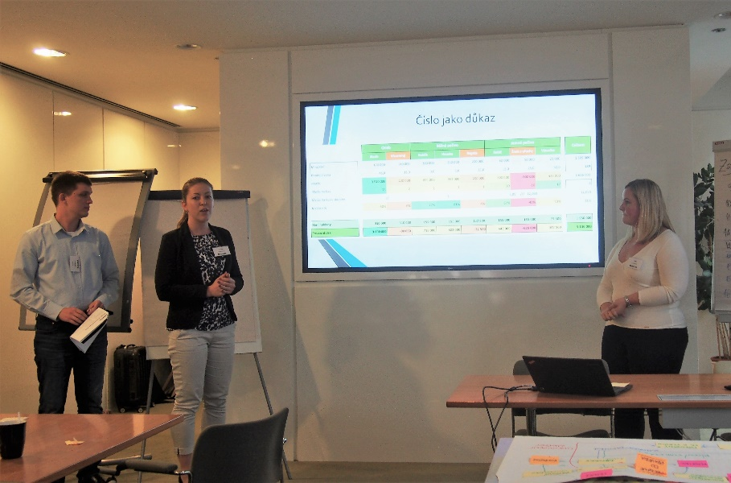
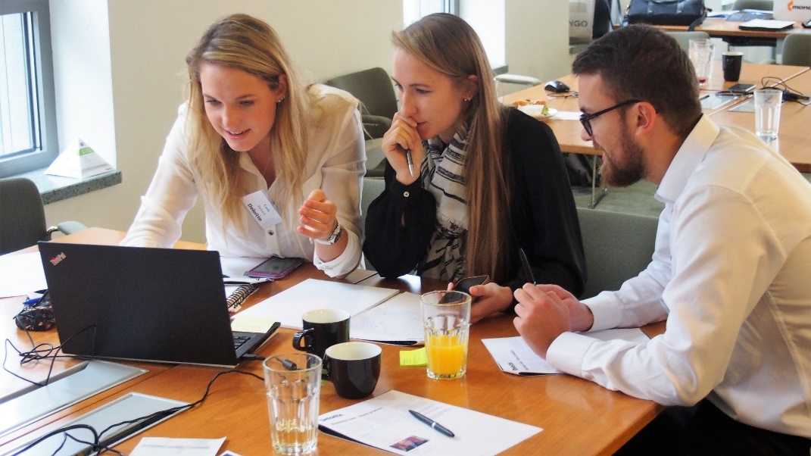
Experience Management Consulting
October 5th, 2017
Nile House
“My friend recommended this workshop to me and I will definitely do the same. Thank you!“
“Amazing experience. I had theoretical knowledge of consulting but today I had a chance to get all day long hands-on experience. It was brilliant!“
“I am pleasantly surprised by Consulting.
I think I will choose Consulting as my minor now. Great experience.“

Slide 7

Technology Fast 50 CE
Results
A Czech firm won in the main category !
#1
Kiwi.com
The fastest growing technology company in Central Europe in 2017

Slide 8
Technology Fast 50 CE Results
Czech companies scored in 2017!
Fast 50
Category
Big 5
Category
Raising Stars
Category
The most disruptive innovation
#1 Kiwi.com
#3
Prusa Research
#1
ZOOT
#7
Pilulka Distribuce
IDEA RS
among 10 finalists
#14
STRV
#15
ZOOT
#37
INVENTI Solution
For more information visit www.deloitte.cz/fast50

Slide 9
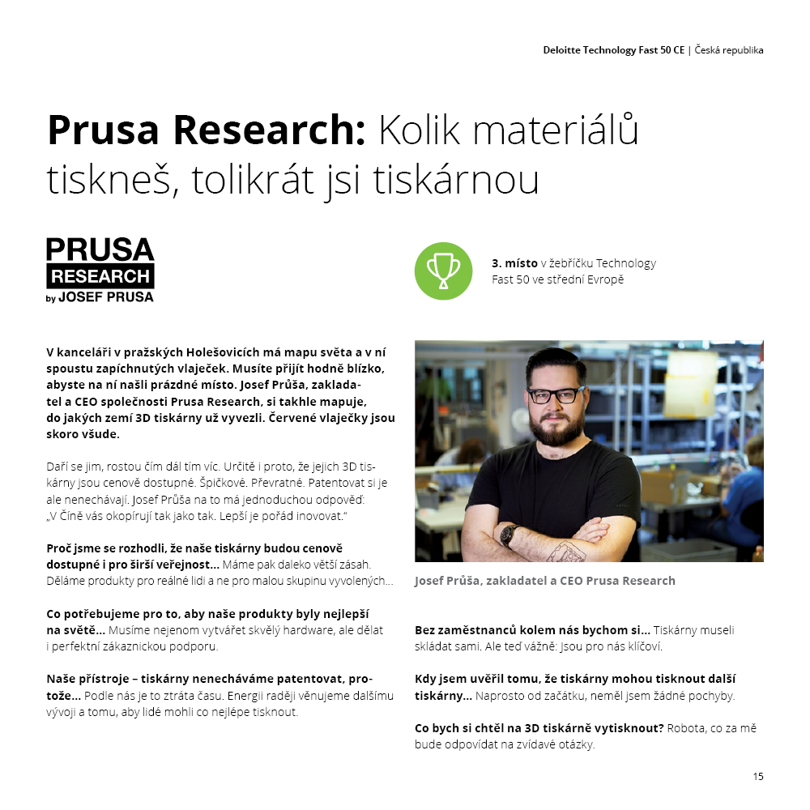

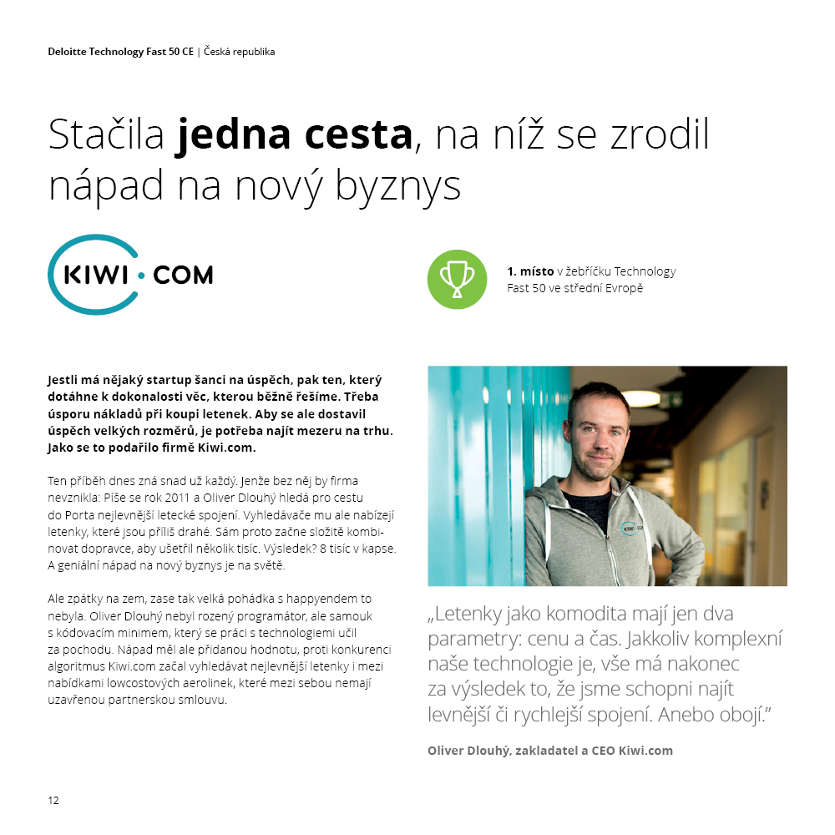
Technology Fast 50 CE:
Speciální česká brožura!
11 příběhů a rozhovorů
Poznejte nejrychleji rostoucí technologické firmy
Brožuru připravil Content tým v oddělení C&M
Více informací poskytne Klára Vyskočilová

Slide 10
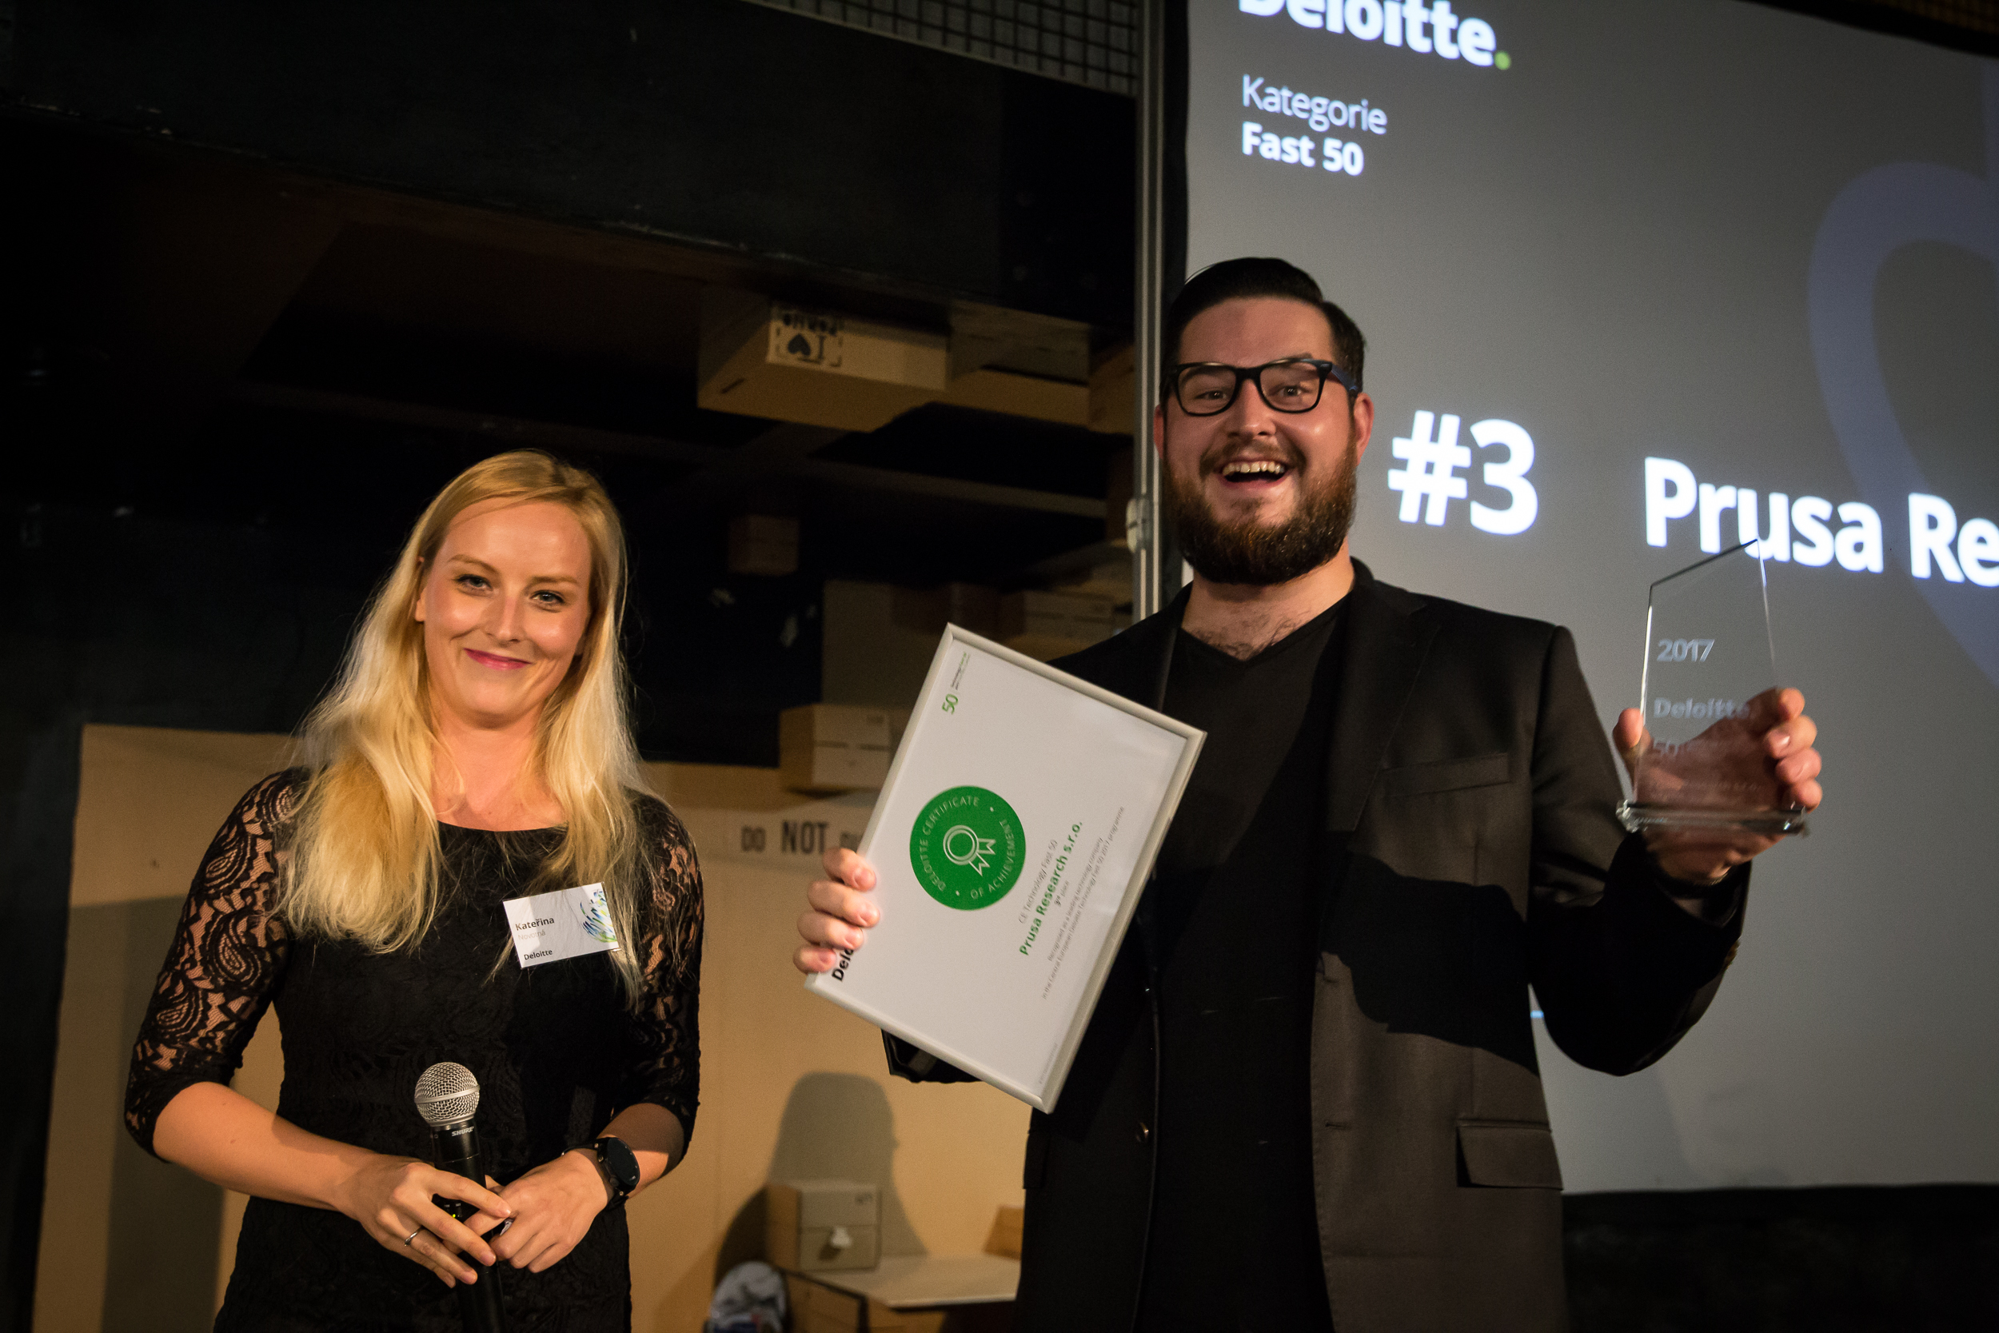
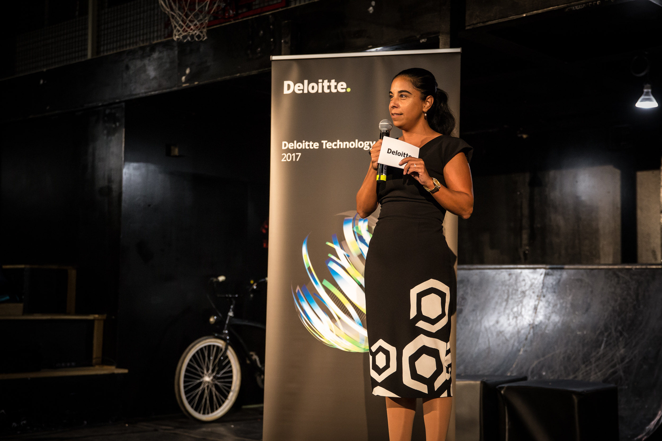
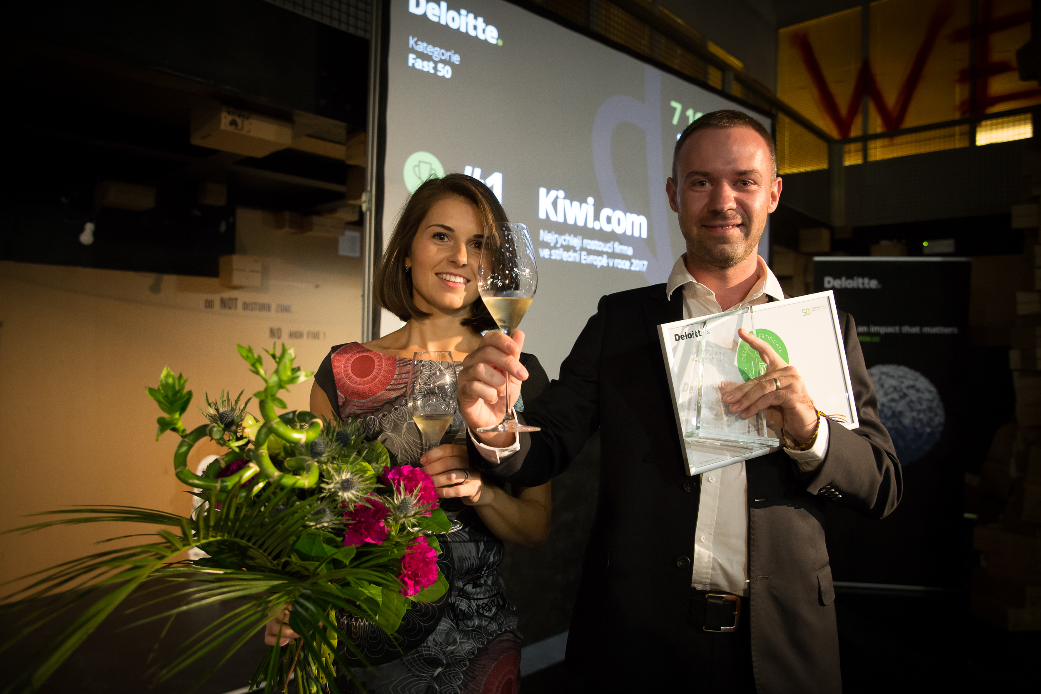
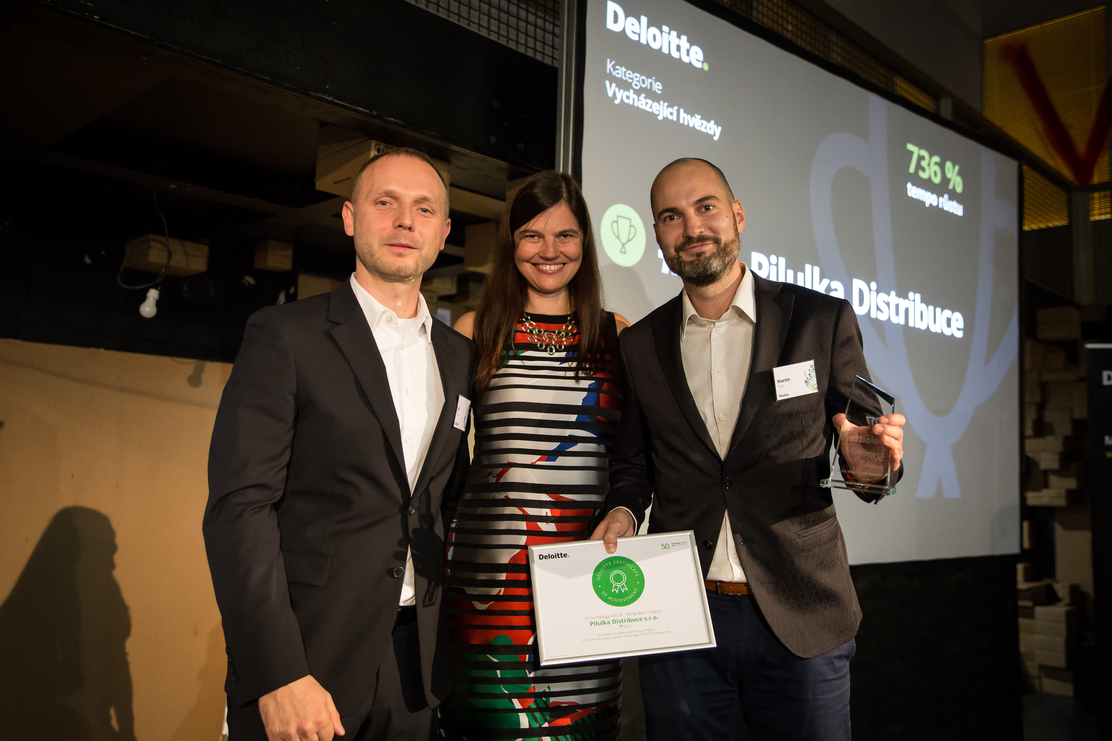
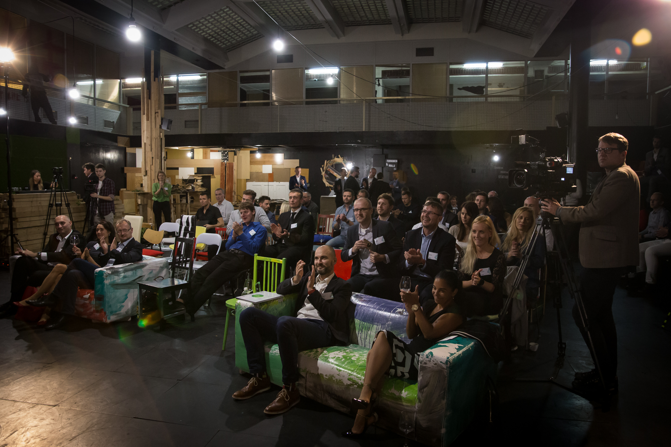
Technology Fast 50 CE
Prague’s Ceremony

Slide 11
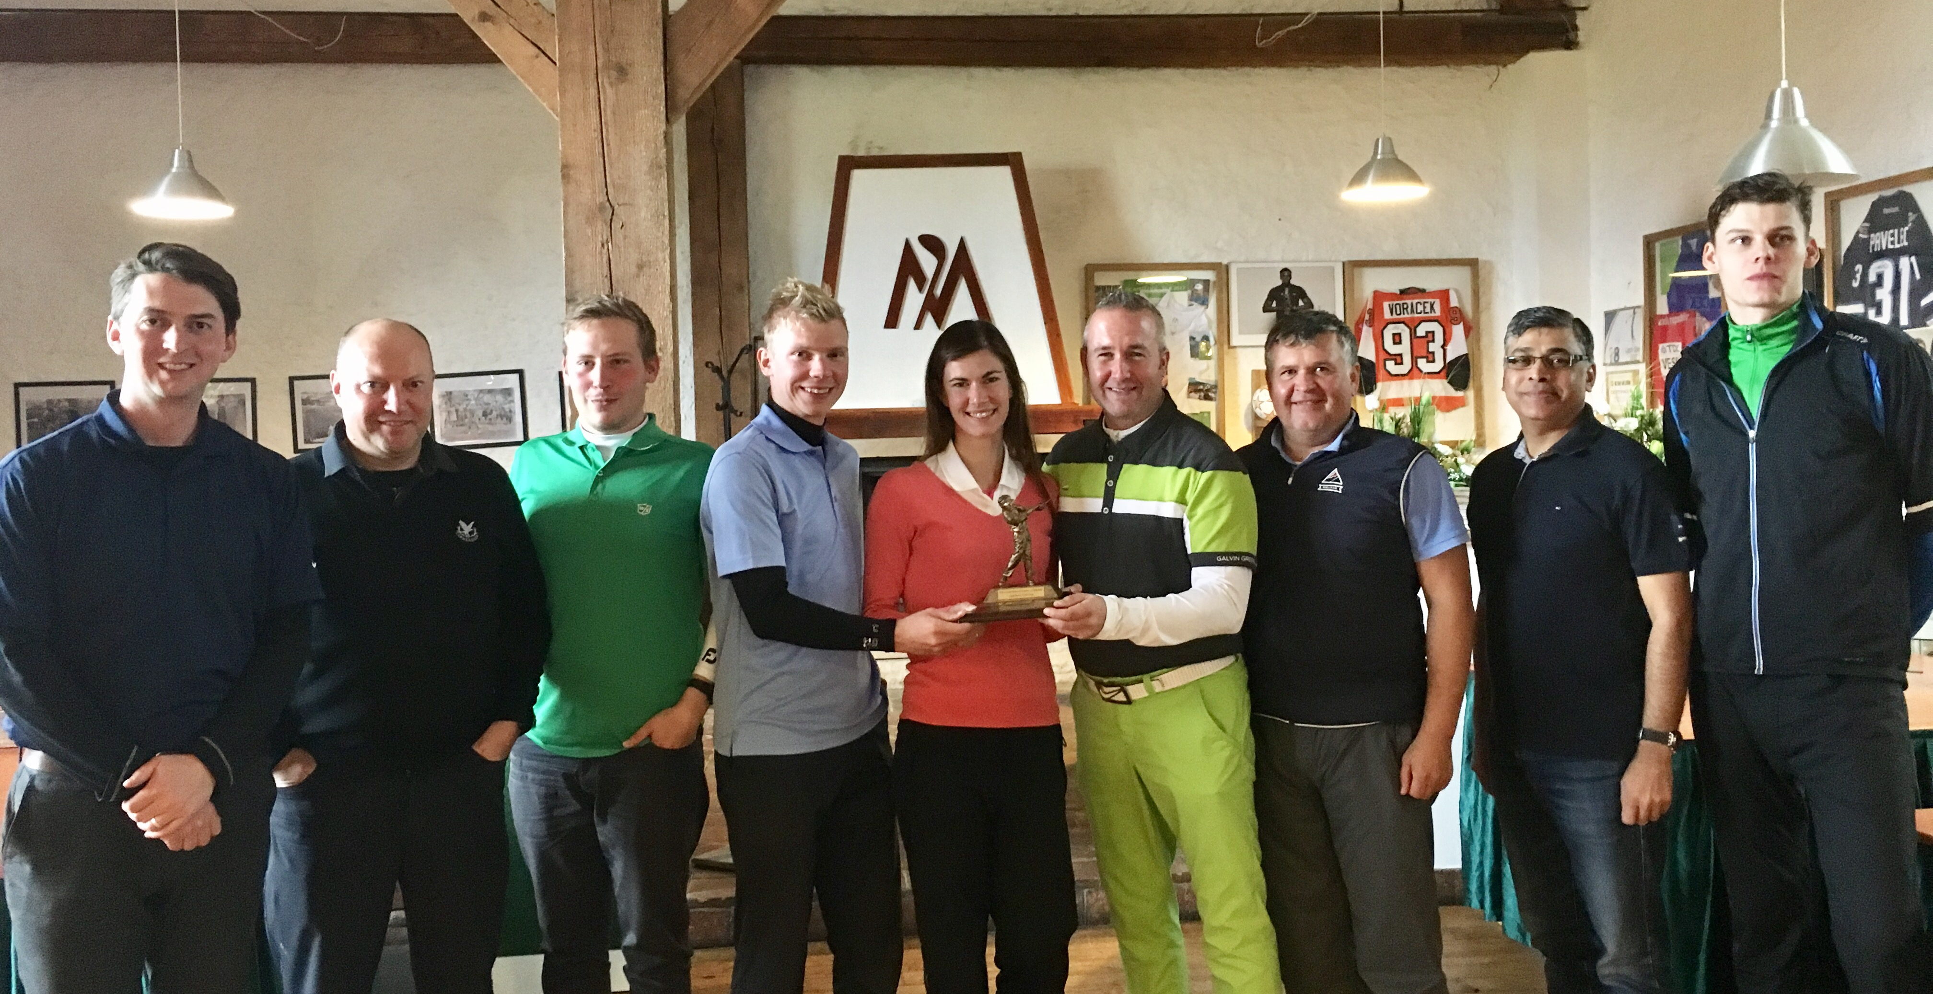
Team Deloitte victorious!
The 9th annual Up & Down golf match between golfers from Deloitte and PwC took place at Mstetice Golf Club on Sunday 8 October. Golfers from each firm battled against each other and windy conditions, and after an exciting day of golf it was the team from Deloitte who lifted the trophy!
Notable performances on the day came from Martina Zapletalova (Consulting), Radek Ullrych (FAS) and Larry Human (Tax) who all scored 40 points or more. The team from Deloitte (see photo) included representatives from Audit, Consulting, Internal Services, FAS, Risk Advisory and Tax & Legal, with everyone contributing to the success.
.
For more information please reach out to Andy Newman

Slide 12






Czech team part of Deloitte Global Business Services Eminence Group
Practice: Global Business Services
Central Eminence Team
Tasks of the Central Team
Discuss on current challenges, improving Deloitte marketing / launch initiatives and sharing of eminence plans in the GBS area across markets
Align on eminence activities to avoid overlapping and working together as one global firm
Czech team led by Pavel Šimák became a core member of the Deloitte Global GBS Eminence Team, composed of 6 leading countries
Our clients expect us to know the GBS and SSC market
For more information please reach out to Pavel Šimák

Slide 13

New client
Economia. Mediální společnost, která se orientuje na vydávání ekonomického tisku (např. Hospodářské noviny, Ekonom, Respekt). V posledních letech významně buduje i svoji působnost na poli digitálních médií (např. iHNed.cz, Aktualne.cz, Centrum.cz, Atlas.cz).
Pro podporu svého dalšího rozvoje se rozhodla zaměřit na modelování budoucnosti a vybudování integrovaného plánovacího modelu založeného na porozumění a simulaci základních business driverů svého podnikání.
Velice si vážíme skutečnosti, že si Economia pro realizaci svého záměru vybrala jako partnera Deloitte.
For more information please reach out to Milos Ungr or Martin Venzl

Slide 14

Recent New Wins
Sokolovská uhelná, a.s.
Optimization of energies production and trading
395,000 EUR
+ success fee
Consulting
Martin Čermák, Miroslav Cink

Slide 15
Recent New Wins
ZF Engineering Plzeň s.r.o.
Konica Minolta Business Solutions Czech Republic
140,000 EUR
EUR 130,000
Tax
A. Weber, L. Hanáček, J. Wiederhold, O. Svejkovsky
Tax
L. Hanáček, P. Chytilová,
G. Jansová

Slide 16
Recent New Wins
ELT Management Company
Czech Republic s.r.o.
ELT Management Company
Slovakia s.r.o.
EUR 206,858
200,000 EUR
Legal & Consulting
Legal and Consulting teams led by T. Babáček
Legal & Consulting
Legal and Consulting teams led by T. Babáček

Slide 17
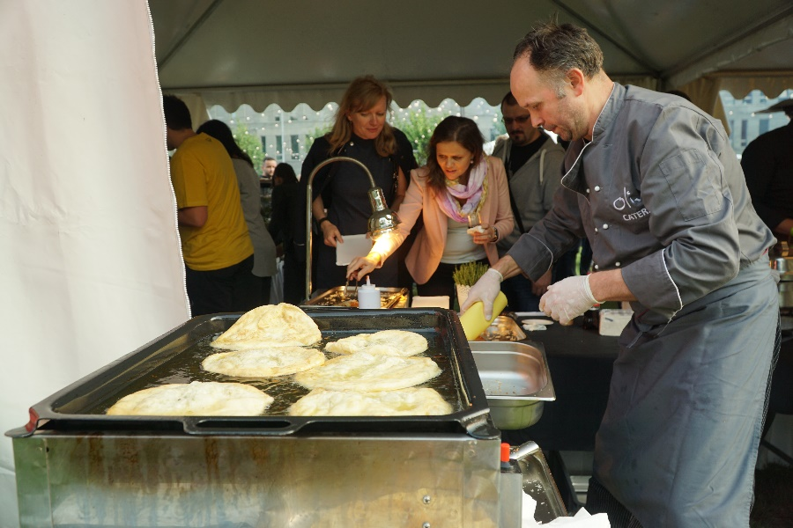
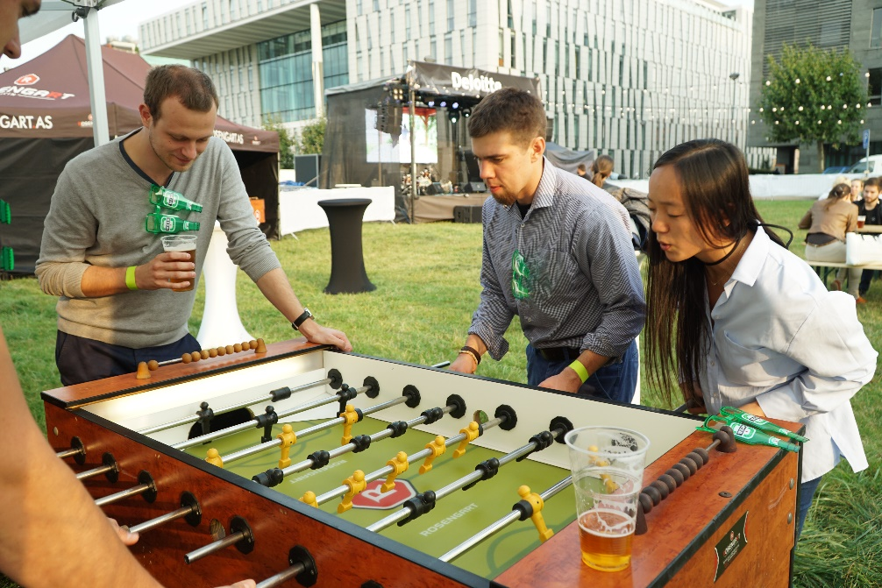
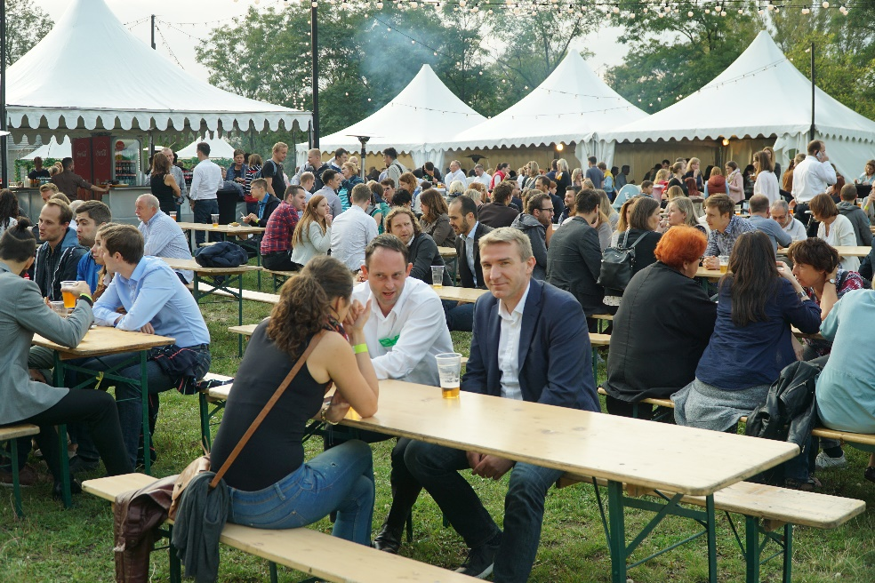

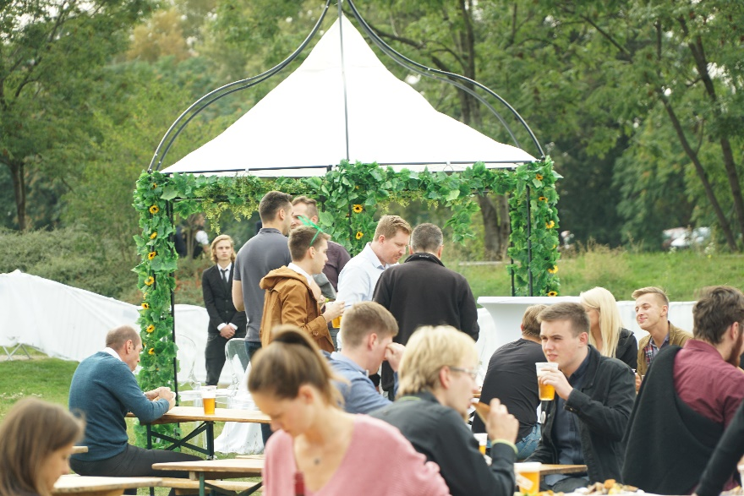
Beerfest 2017

Slide 18
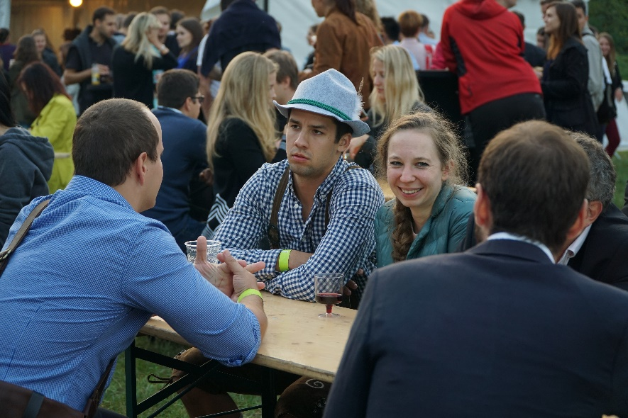
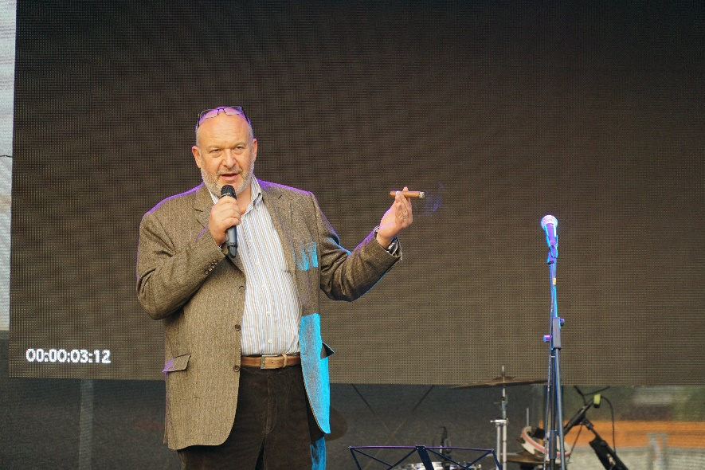
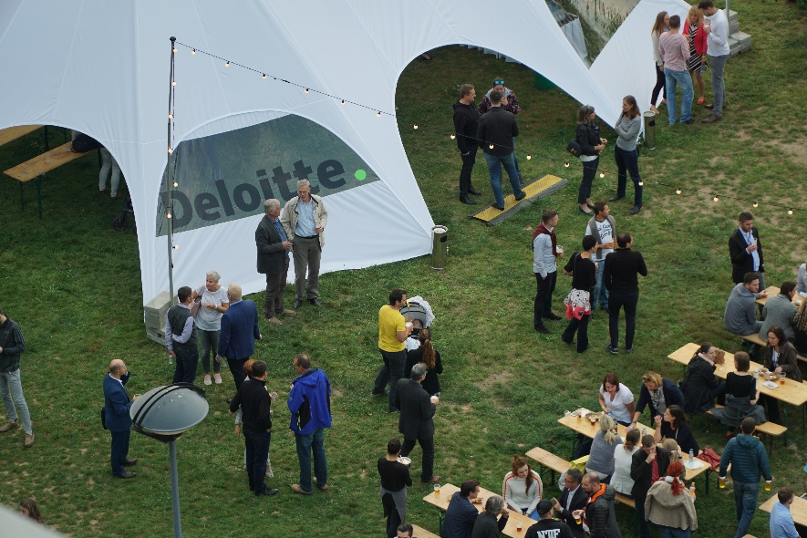
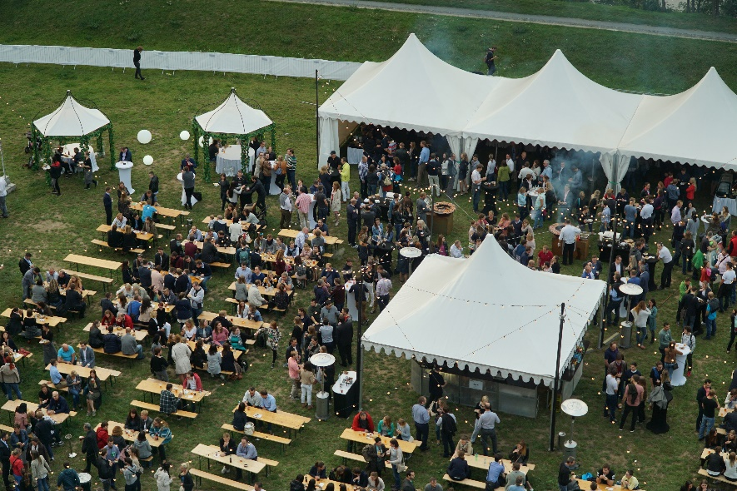

Beerfest 2017

Slide 19
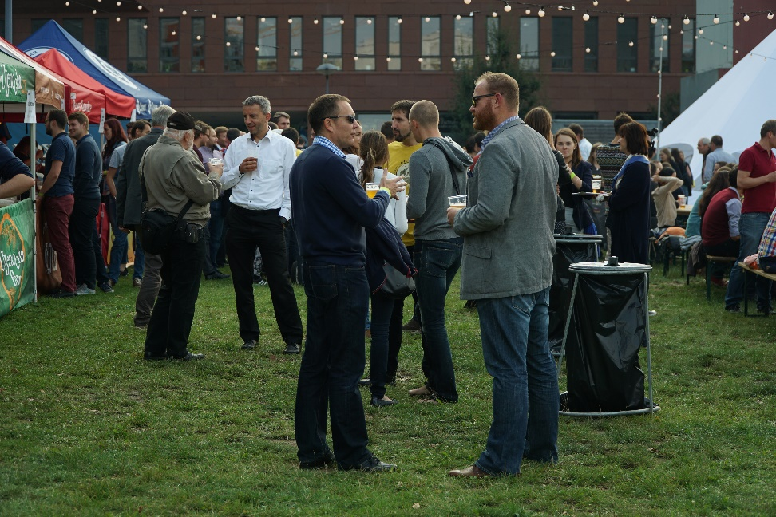
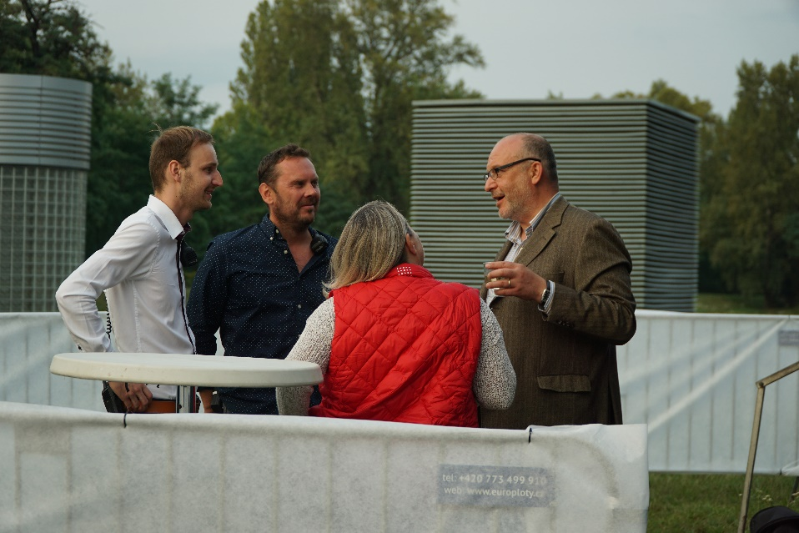
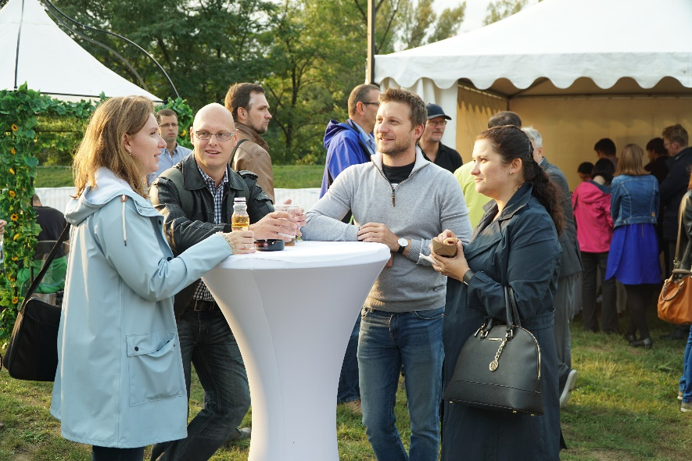
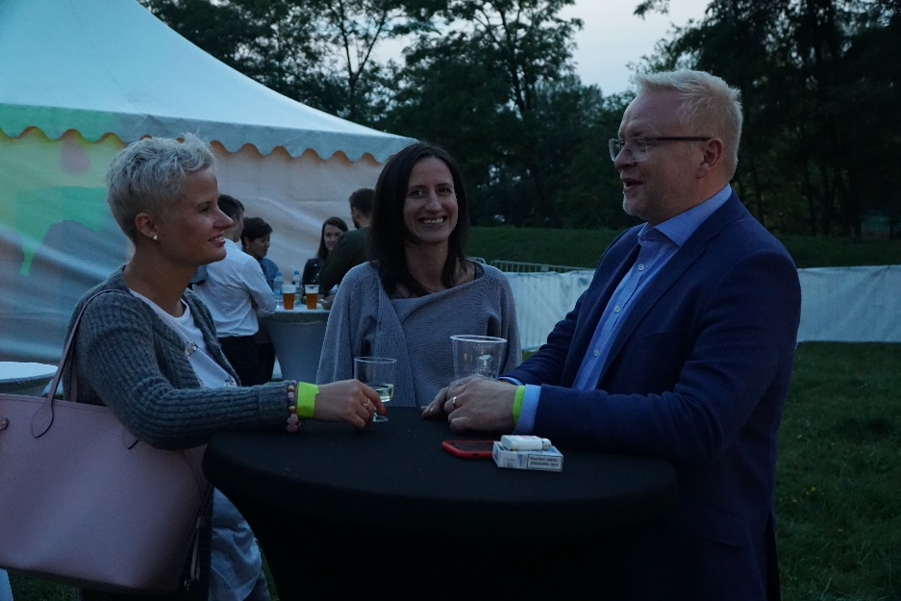
Beerfest 2017

Slide 20
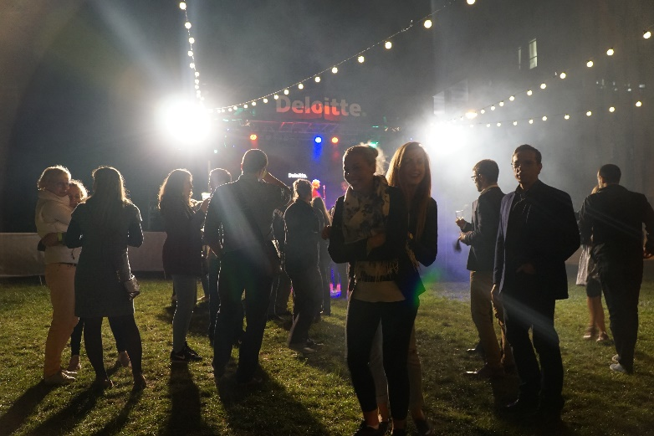
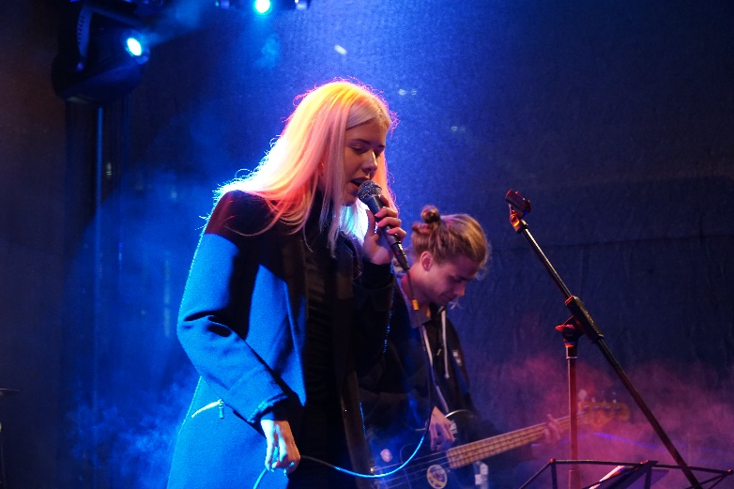
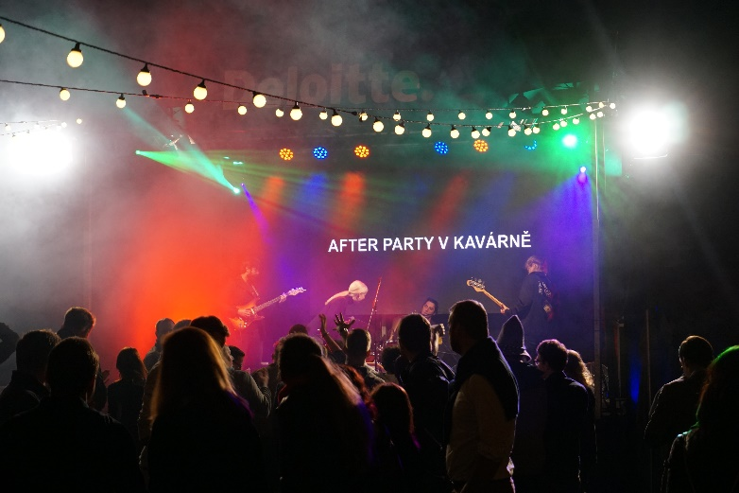
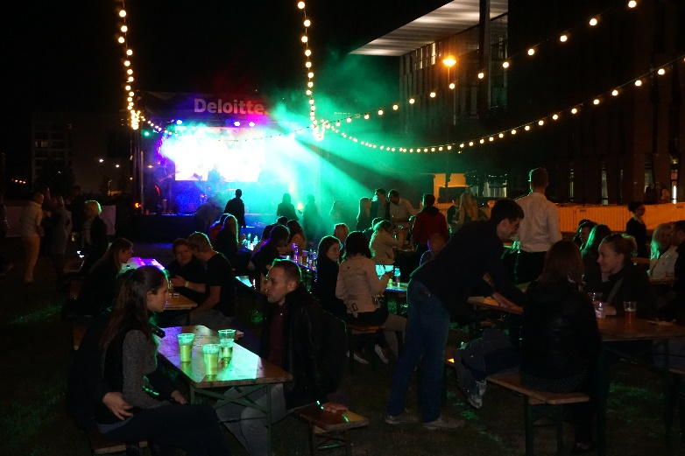
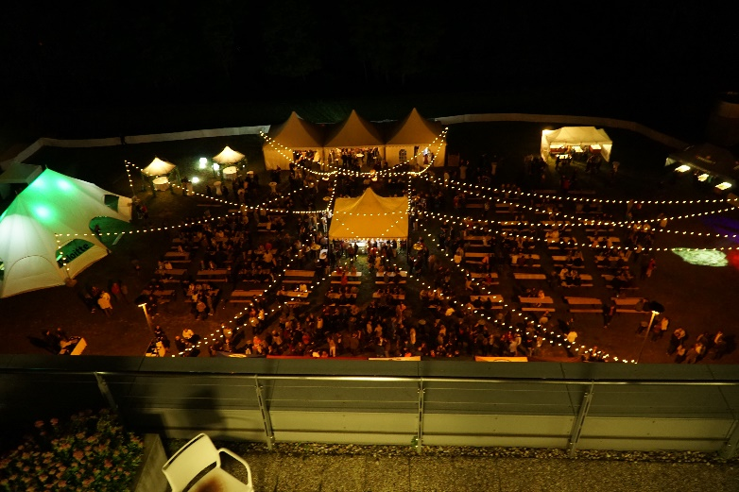

Beerfest 2017

Slide 21
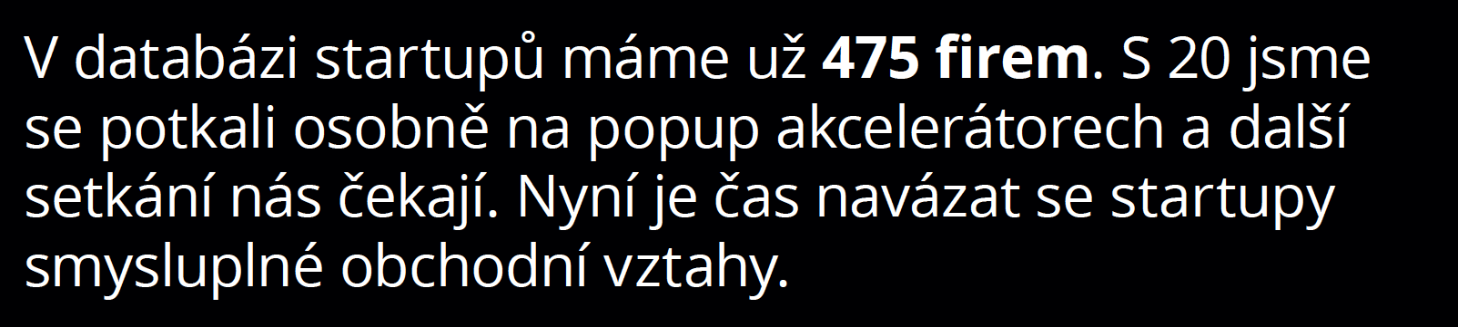

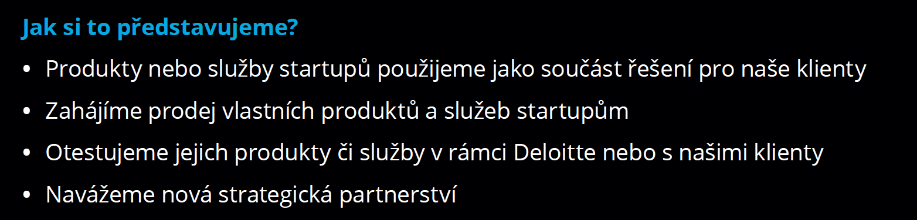
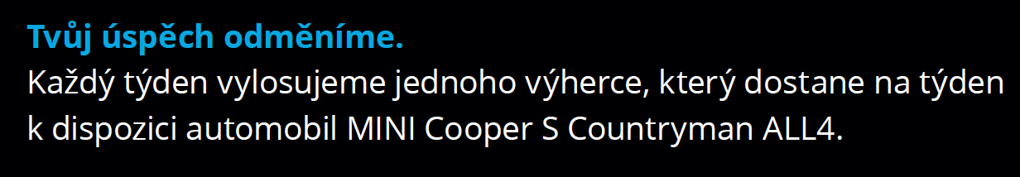
Chceš týden řídit MINI? Pracuj se startupy!
Podrobnější informace o soutěži: http://bit.ly/Soutez-Mini
ignitebydeloitte@deloittece.com

Slide 22
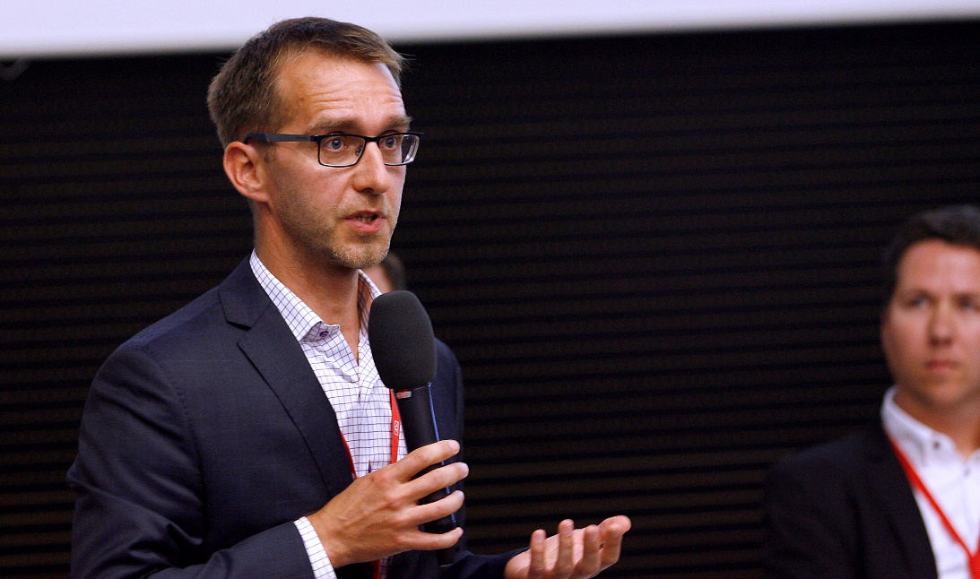
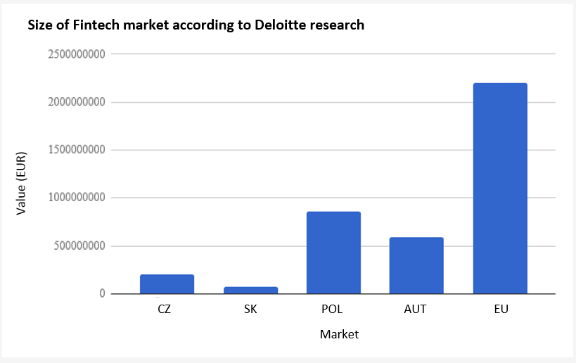
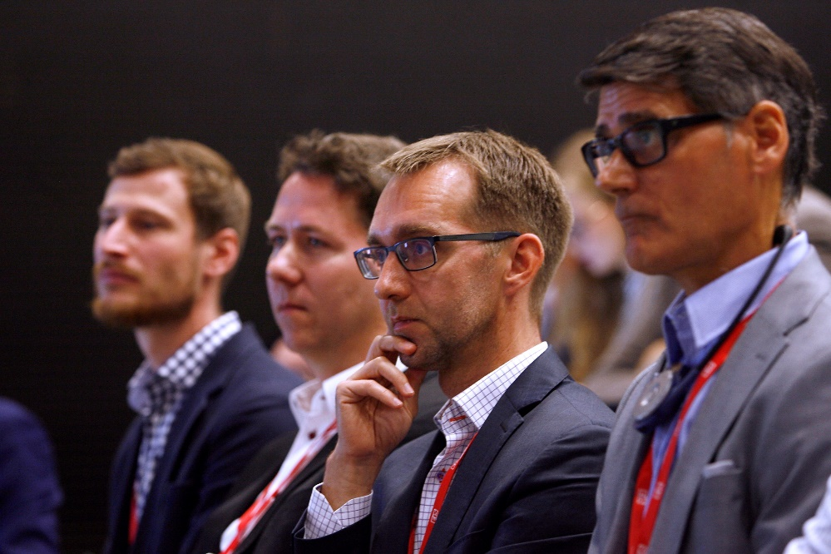
Deloitte @ E15 Fintech Revolution II Conference
How will PSD2, a new EU directive on payment services, influence the financial services market? This was one of the topics debated at the Fintech Revolution II conference which was organised by the E15 daily. Roman Lux from Deloitte Czech Republic was among the presenters and panellists.
“Fintech companies taught banks how to innovate and set the direction. They also enlightened clients as regards their rights to the quality of financial products. And have reshaped customer expectations, setting new and higher bars for user experience. (…) Nevertheless, the ability to innovate is derived from the unique ability to transform an idea or invention into a service or product for which a client will be willing to pay.”
Roman Lux, Assistant Director, FAS
More details and the complete article is available on the Intranet – section Deloitte in the media

Slide 23

Work opportunity for Senior Consultants
We are looking for a Deloitte Private project coordinator
Currently as a 60% part-time position, full-time going forward
Join us in supporting family and private clients by becoming a coordinator
of a key initiative
What will be your tasks?
  Setting up the process with the management team, coordinating
  the whole project
  Overseeing Key Account Managers for our Deloitte Private clients
  Working with different internal systems, e.g. O2E
  Communicating and working closely with partners across Deloitte
What will you not do without?
A very good grasp of English – experience in project management –
knowledge of Deloitte’s environment – assertiveness – proactive approach
For more information contact vmuckova@deloittece.com

Slide 24
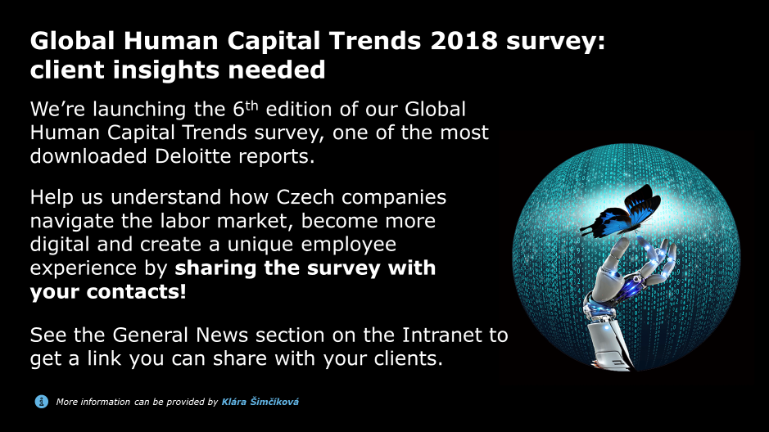

Slide 25
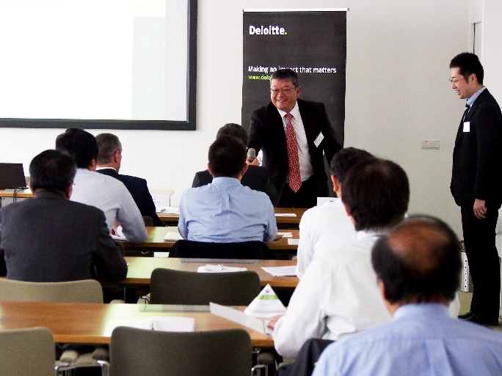
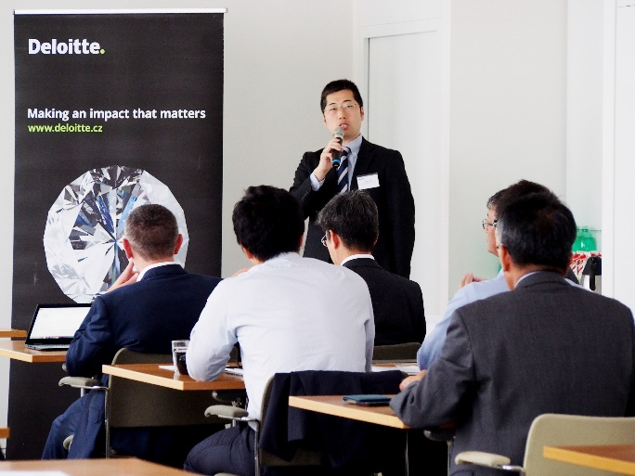
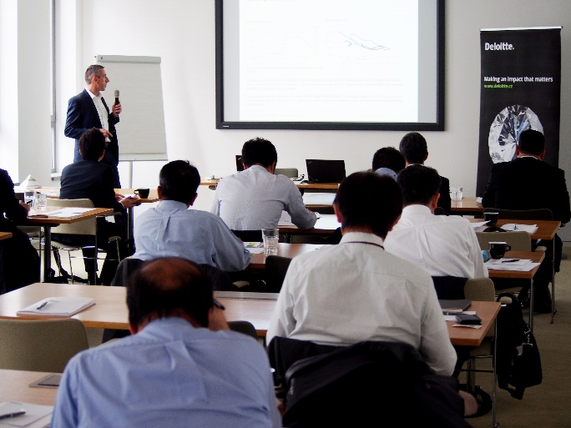
Economic Situation and FX Outlook in Europe
Our joint seminar with Sumitomo Mitsui Banking Corporation on “Economic situation and FX outlook in Europe“ was held in Prague on 15 September 2017. The event had two main speakers - Deloitte’s economist David Marek, and SMBC’s expert from Japan, Yoichiro Yamaguchi.
For more information please reach out to Tereza Kavan Klimesova

