Slide 1
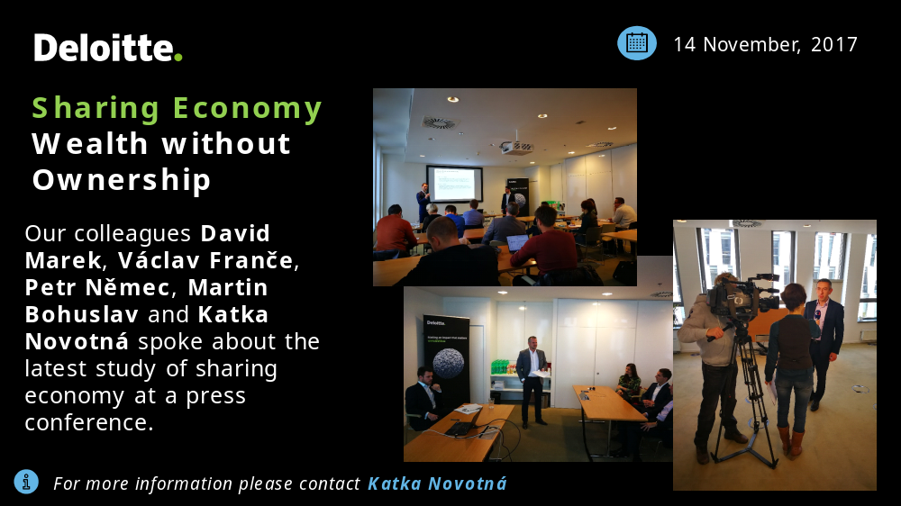
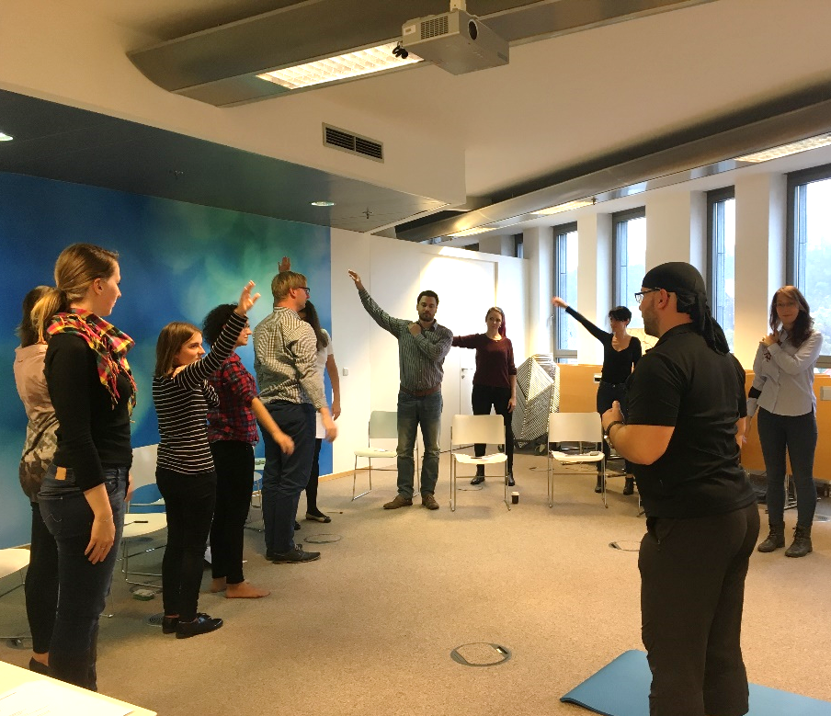
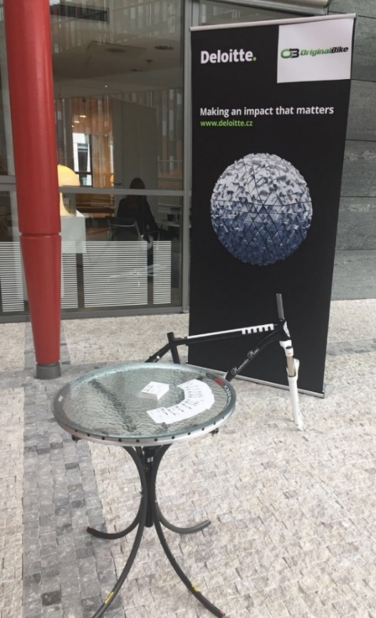
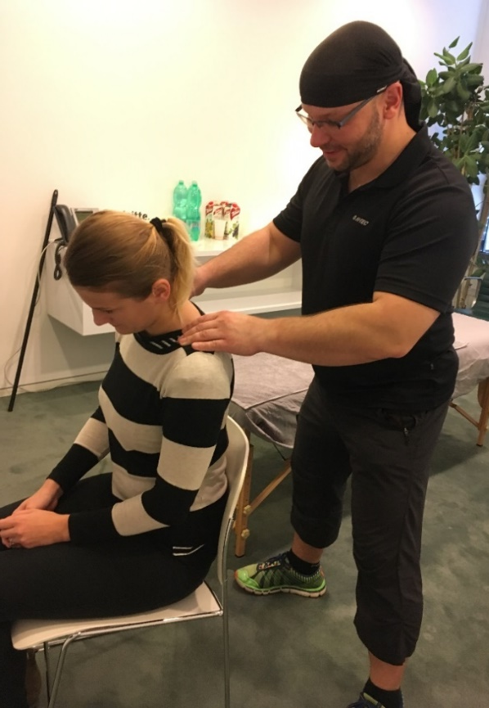
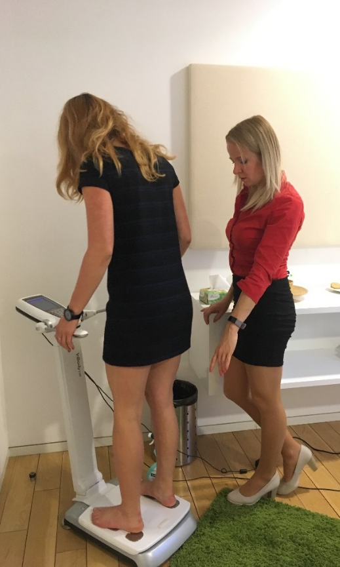
Health Day
10 November 2017
For more information please contact Lenka Tomášková

Slide 2
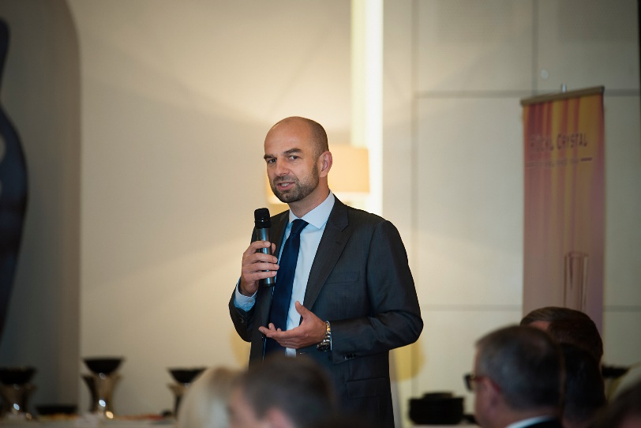
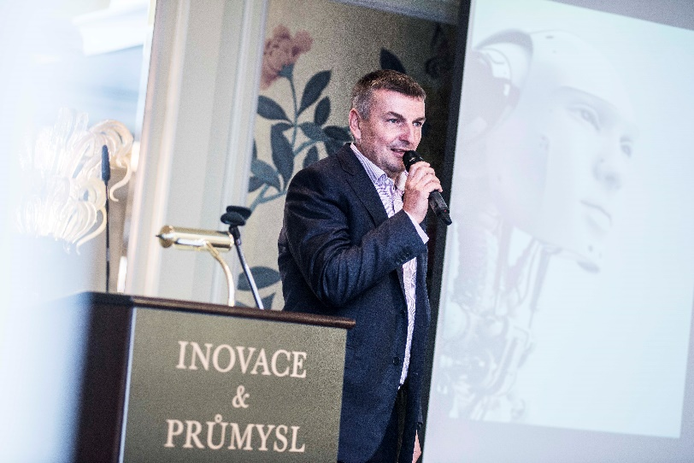
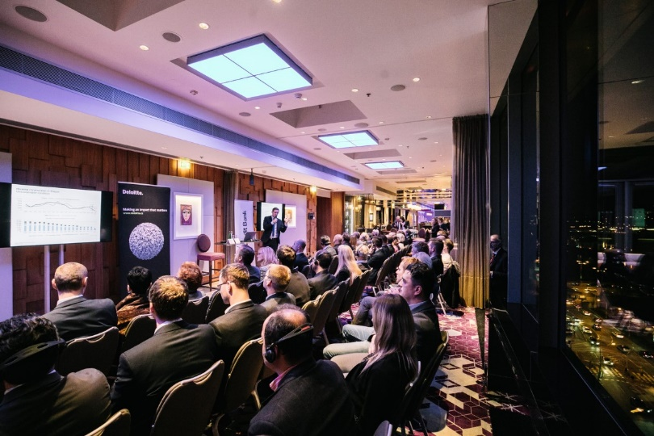
Building Brand Eminence
Jan Spáčil on an event organized by the Czech Institute of Directors in the Mandarin Oriental hotel where he introduced a Czech version of the OECD Guidelines on Corporate Governance. There were key potential clients, Minister of Transport, Minister of Finance, Minister of Industry and top media present.
Miroslav Linhart gave a presentation focused on Prague development and future of the Czech real estate market at an event organized by the Italian-Czech Chamber of Commerce and Industry that took place in the Hilton hotel.
Milan Kulhánek giving speech about Industry 4.0 on E15 Premium (key business magazine in the CR) event that took place at Four Seasons hotel in the presence of big potential clients and top journalists.

Slide 3
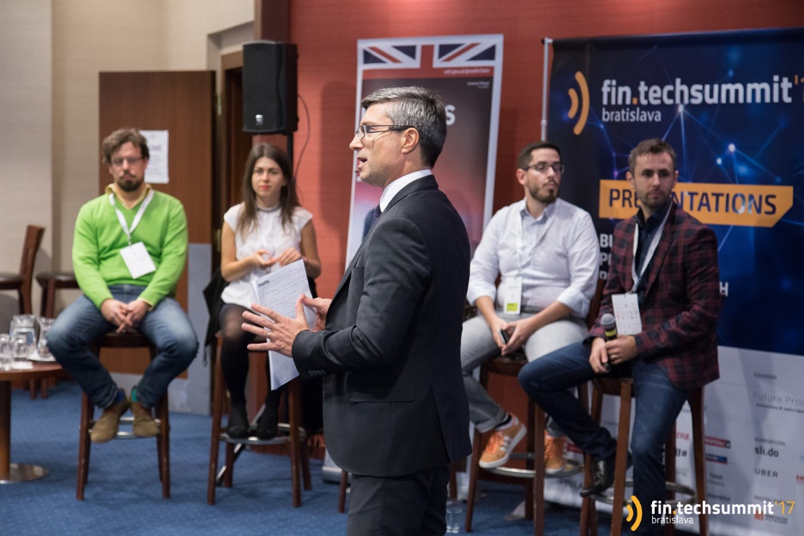

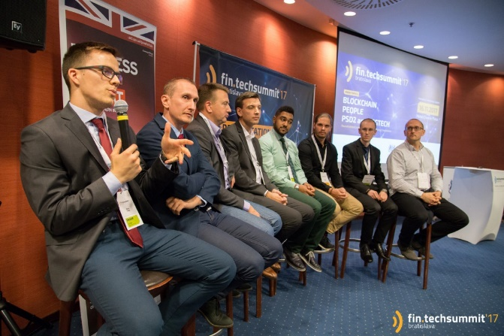
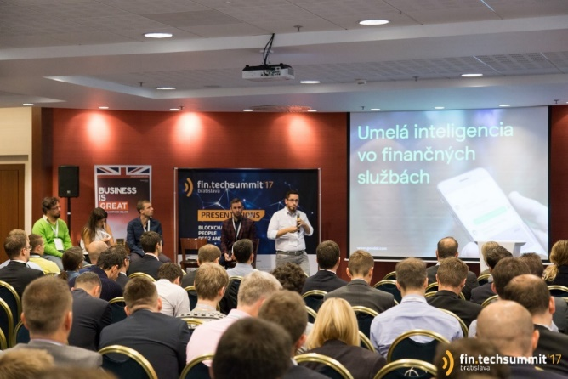
Fin.TechSummit 2017
Petr Brich assumed the role of a moderator of the Presentations stream at the first international Fin.TechSummit conference held on 16 November 2017 in Bratislava
The event focused on Blockchain/Cryptocurrencies, GDPR, Cyber security and PSD2
It also presented an interesting case study of a new digital 365.bank successfully teaming up with four fast growing Czech and Slovak Fintechs.
For more information please reach out to Petr Brich

Slide 4

Now for the 10th time, SheXO is back!
When
January 11th
Where
ELI | beamlines
New Laser Center in Dolní Břežany
(Parking and transportation provided)
Please share your nominations!
Senta Čermáková
scermakova@deloittece.com

Slide 5
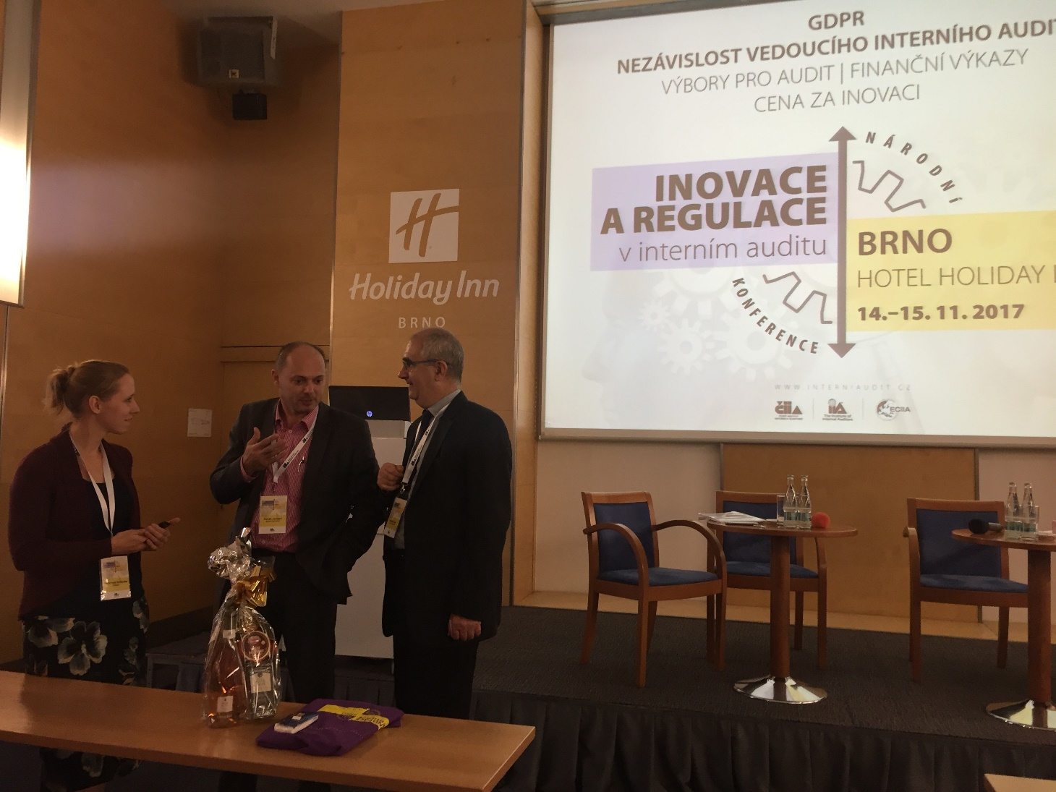
National Conference Brno 2017
14 November 2017
Our colleagues Veronika Počerová and Y My Vu Thi presented to companies how to utilize internal corporate data and advanced analytics in addressing employee retention.
It is a beautiful example of cross-team cooperation, in this case Advanced Analytics and HCAS.
For more information please contact Veronika Počerová

Slide 6
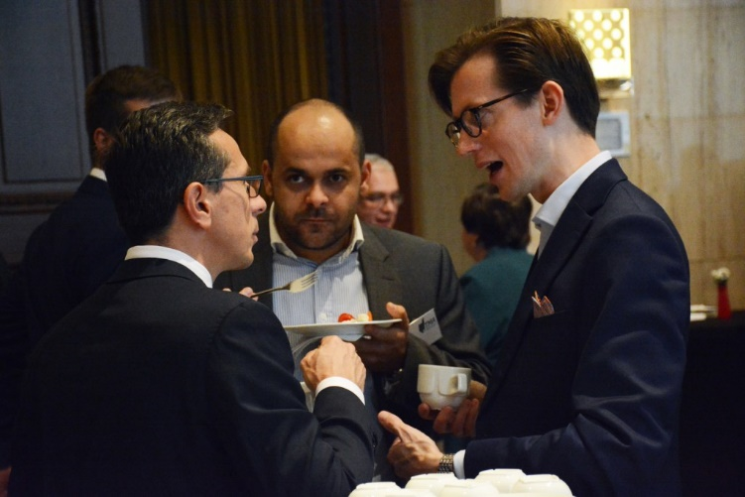
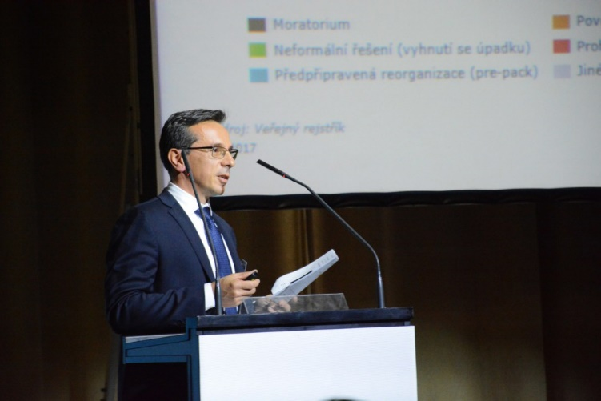
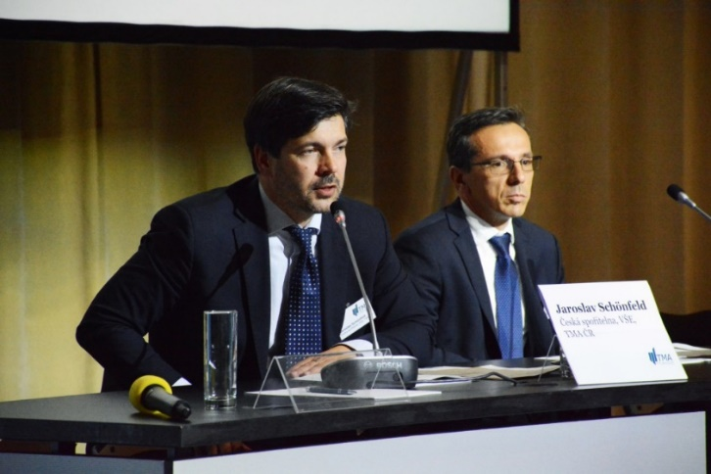
Restructuring Forum of 2017
31 October 2017
Colleagues from Corporate Finance and Restructuring took part in the 6th annual professional conference Restructuring Forum of 2017. Deloitte was one of the main partners of the conference.
This conference was attended by over 200 experts who deal with corporate restructuring and crisis management.
The main speaker for Deloitte was Radim Baše, who gave a talk on Using Pre-insolvency Moratorium in Practice.
For further information, please contact Radim Baše

Slide 7
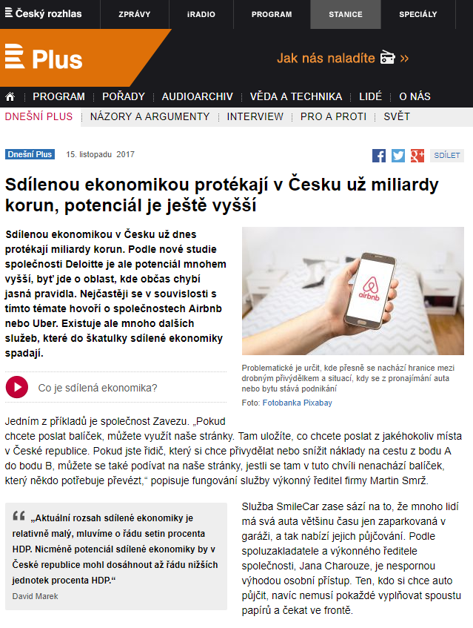
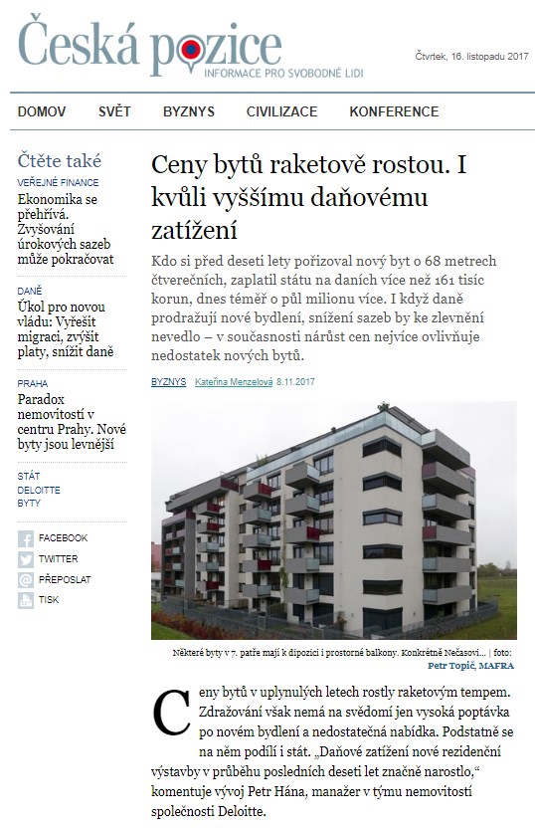
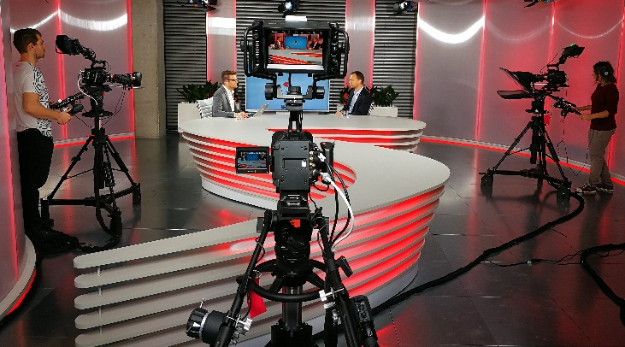
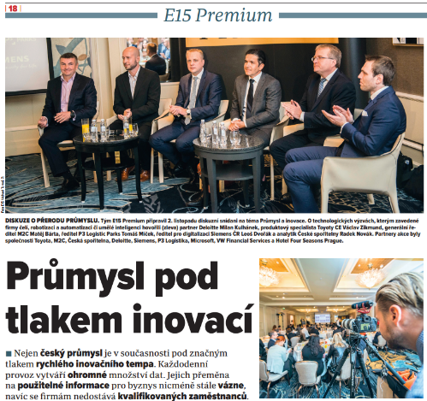
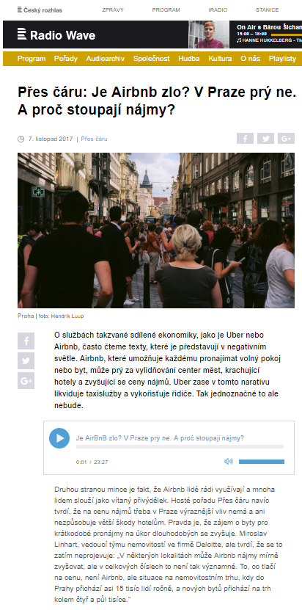
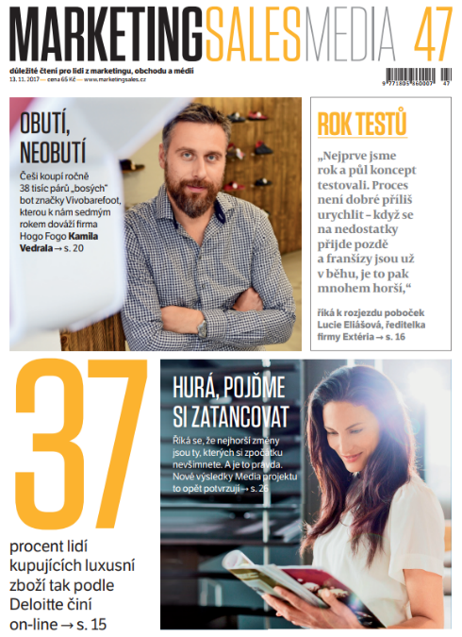
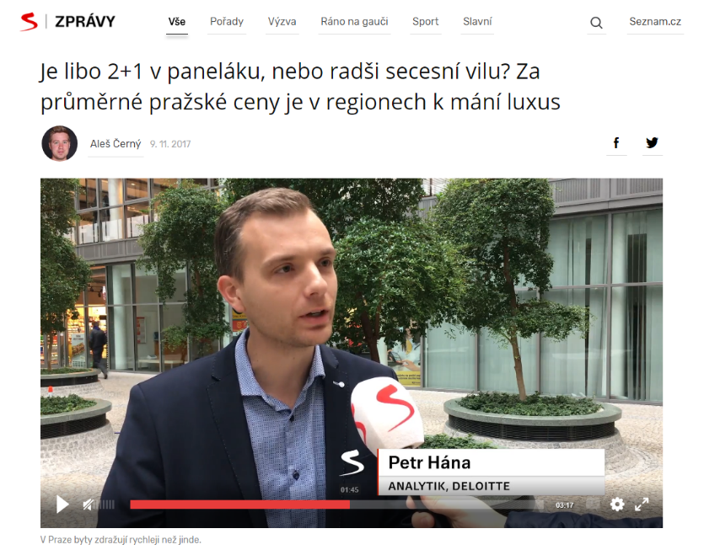
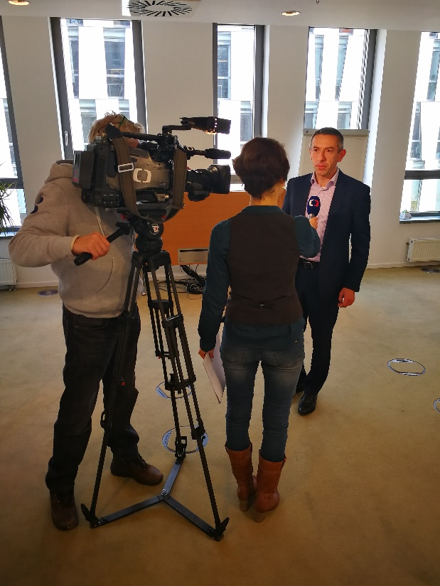
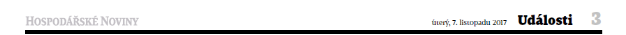
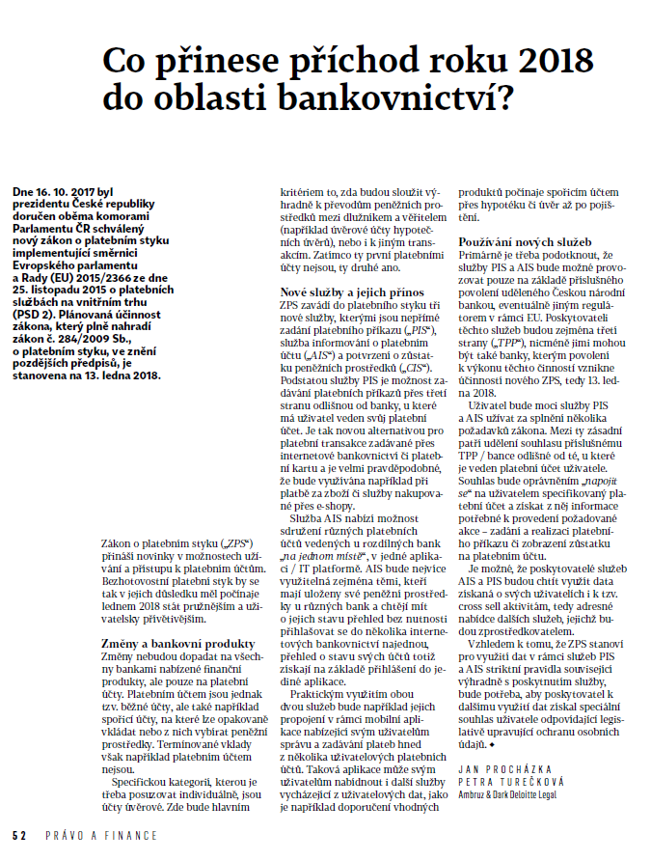

Deloitte in the media
248x in the 1st half of November.
Do you also have anything to say?
Contact PR team: mmalysa@deloittece.com, achocholata@deloittece.com.

Slide 8


GDPR Detective
Will check the personal data processing from A to Z
Ambruz & Dark Deloitte Legal has developed an online application to help companies find their way in the GDPR and to prepare them for new personal data processing rules.
The GDPR Detective will investigate the following areas:
Personal data processing principles
Compliance with the information duty
Personal data security
Relations with processors, etc
For more information please contact Martin Bohuslav

Slide 9

Open Positions at Deloitte
BPS
  Senior Accountant
FAS
  Associate (Corporate Finance)
Internal Services
  Graphic Designer
Internal Services
  HR Administrator
Tax
  Senior Consultant (FSI)
Audit & Assurance
  Senior Consultant
Do you know that you are eligible to receive a special STAR awards bonus if you recommend a suitable candidate who
is then hired?
For more information please contact our recruitment team

Slide 10
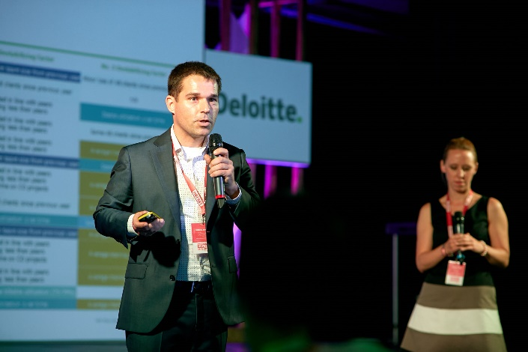
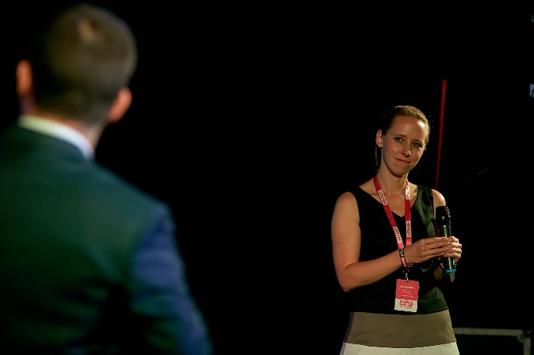
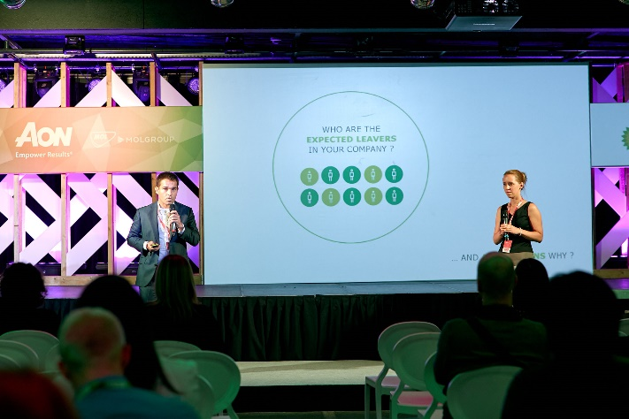
HR FEST in Budapest
The event with about 800 participants focused on the hot topics in the HR. Deloitte Czech Republic was represented by Pavel Šimák and Veronika Počerová who jointly presented the predictive analytics for employee churn.
Pavel was also asked to give an interview on the RTL channel, one of the most popular TV channels in Hungary
October 26th, 2017
For more information please contact Pavel Šimák

Slide 11

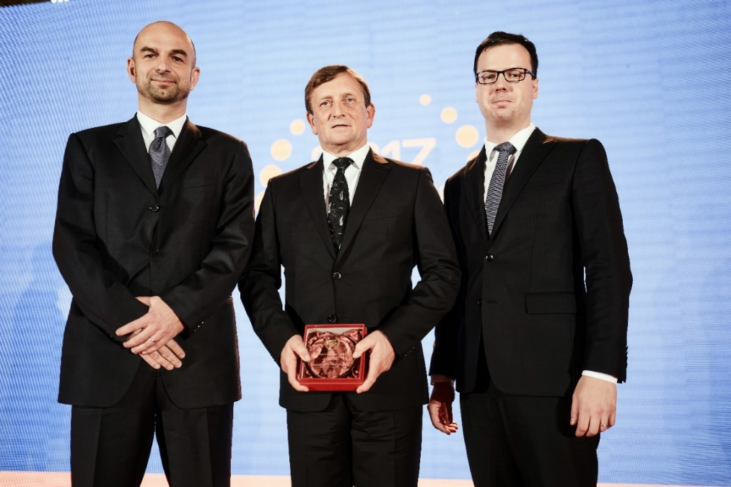
Medal for Deloite Legal
Ambruz & Dark Deloitte Legal has received the Czech Law Firm of The Year 2017 award in the category of Labour Law.
The lawyers also successfully defended last year’s ranking among
Highly Recommended Law Offices in the area of Tax Law.
And it also became a Recommended Law Office
in the following categories:
Corporate Law
Development and Real Estate Projects
Mergers and Acquisitions
Intellectual Property
For more information please contact Dominik Hrodek

Slide 12
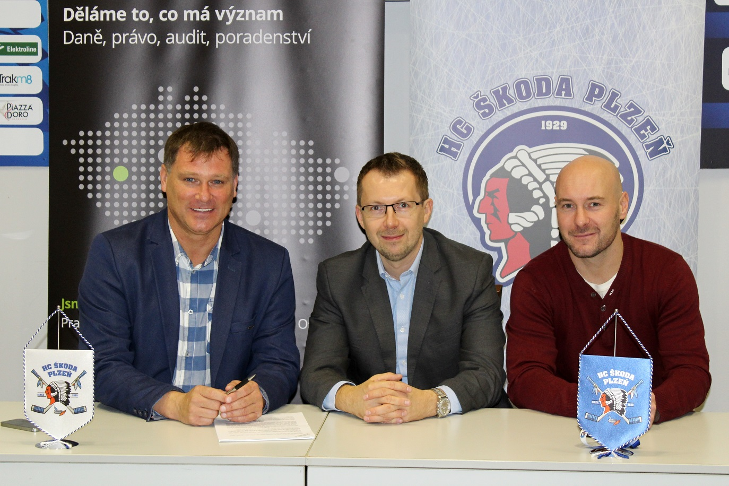
Deloitte becomes a business Partner of HC Škoda Plzeň
  The Škoda Plzeň Hockey Club has revealed another significant partner for the ongoing season
  Tax and legal advisory services to be newly provided by Deloitte.
For more information please contact Antonín Weber

Slide 13
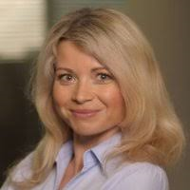
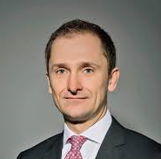
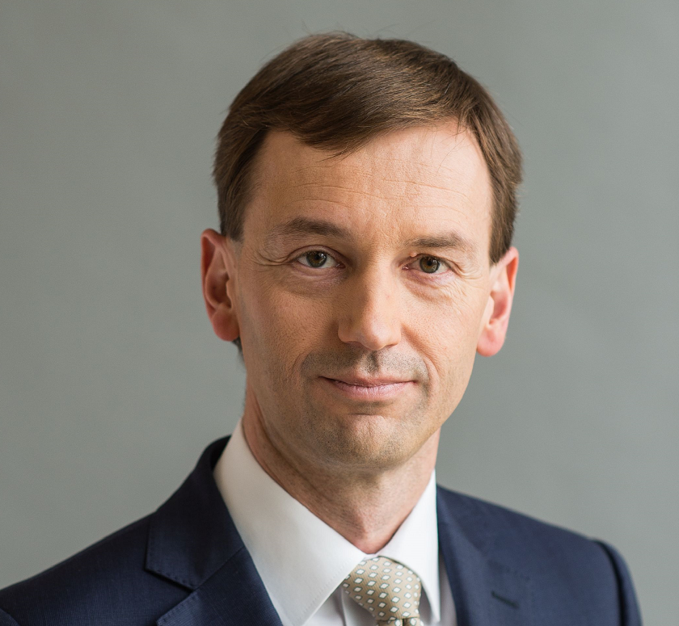
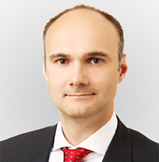
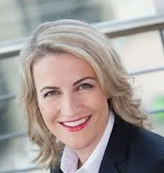
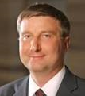
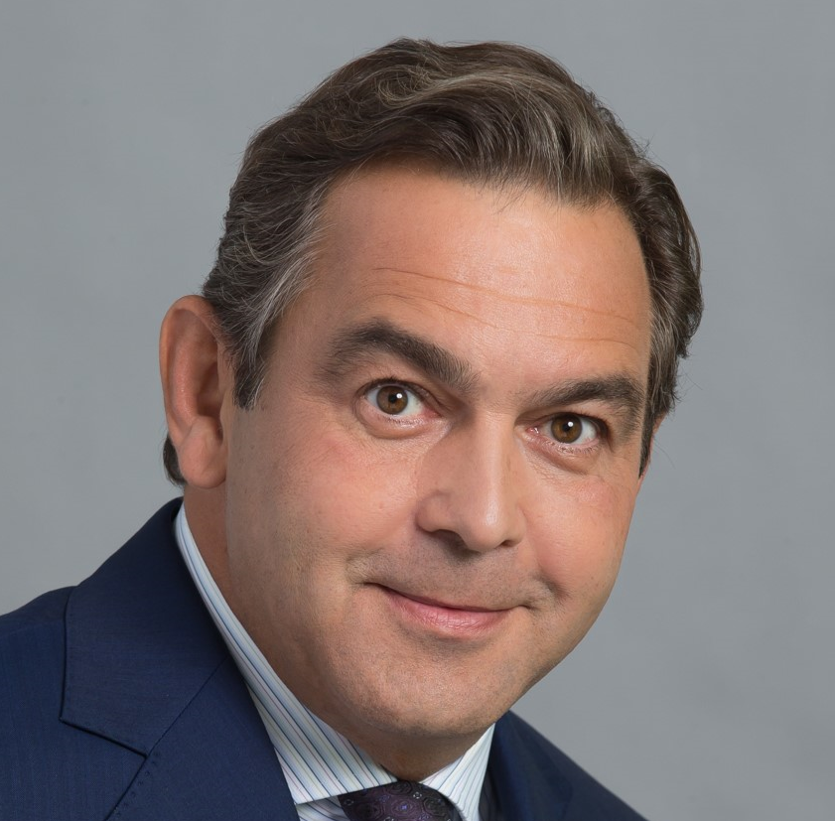
CXO Talks
“CXO Talks” Event
FS Audit / Advisory of the future
On 16-17 October, Deloitte hosted “CXO Talks”, a panel moderated by Diana Rádl Rogerová with seven board members of leading Czech banks – CEOs, CFOs, COOs and a Chief Retail Officer.
The session provided senior FSI professionals from across DCE with valuable insights into the priorities and challenges of CXOs and in how they perceive Deloitte as an Audit and Advisory firm.
The learnings from the event will be reflected in selective adjustments to our services delivery model.
The overall feedback on Deloitte was positive, clearly showing that we have been moving into the right direction with our strategy and offerings:
K. Soukeník, COO Sberbank: “In FS Audit, there are only 2 relevant firms in CZ,
Deloitte being one of them; Deloitte has the broadest skills coverage among Big 4“
L. Tešić, CFO UniCredit: ”Up to 30% of CFO time goes to regulatory – regulatory competence of the advisor is key”
T. Spurný, CEO MONETA: “Capability of combining technology with customer experience and data is key for advisors, plus the ability to implement.”
For more information please contact Diana Rádl Rogerová or Petr Brich

Slide 14
Open Positions at Deloitte
Deloitte CE
  Solution Architect
Deloitte CE
  Junior Consultant Independence
FAS
  Associate (Corporate Finance)
FAS
  Associate (Transaction Services)
Tax
  Senior Consultant (FSI)
Internal Services
  HR Administrator
Do you know that you are eligible to receive a special STAR awards bonus if you recommend a suitable candidate who
is then hired?
For more information please contact our recruitment team

Slide 15

Technology Fast 50 CE
Results
A Czech firm won in the main category !
#1
Kiwi.com
The fastest growing technology company in Central Europe in 2017

Slide 16
Technology Fast 50 CE Results
Czech companies scored in 2017!
Fast 50
Category
Big 5
Category
Raising Stars
Category
The most disruptive innovation
#1 Kiwi.com
#3
Prusa Research
#1
ZOOT
#7
Pilulka Distribuce
IDEA RS
among 10 finalists
#14
STRV
#15
ZOOT
#37
INVENTI Solution
For more information visit www.deloitte.cz/fast50

Slide 17
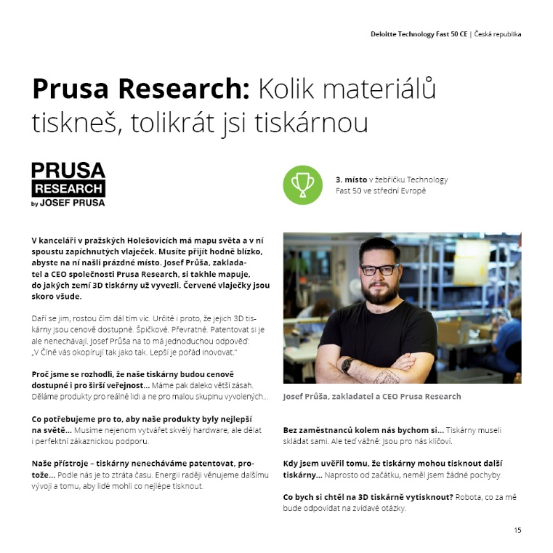

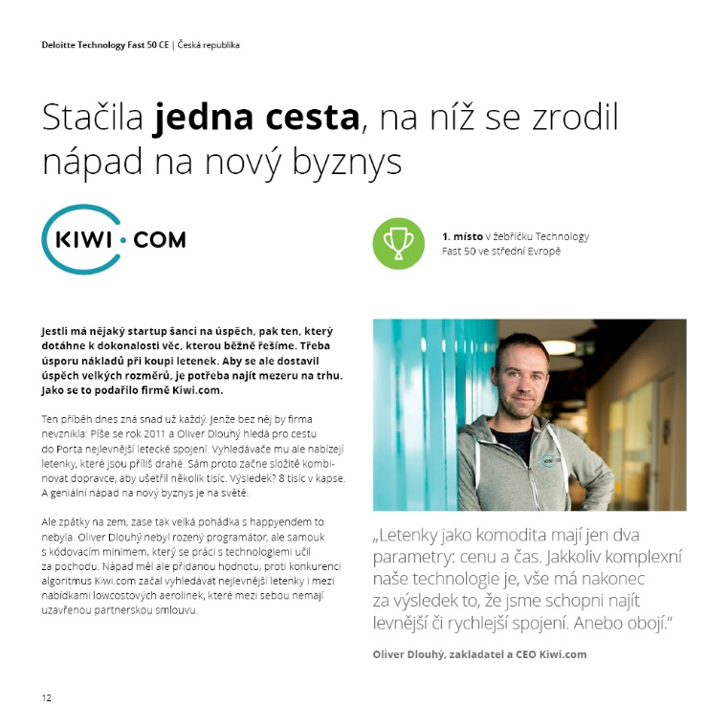
Technology Fast 50 CE:
Speciální česká brožura!
11 příběhů a rozhovorů
Poznejte nejrychleji rostoucí technologické firmy
Brožuru připravil Content tým v oddělení C&M
Více informací poskytne Klára Vyskočilová

Slide 18
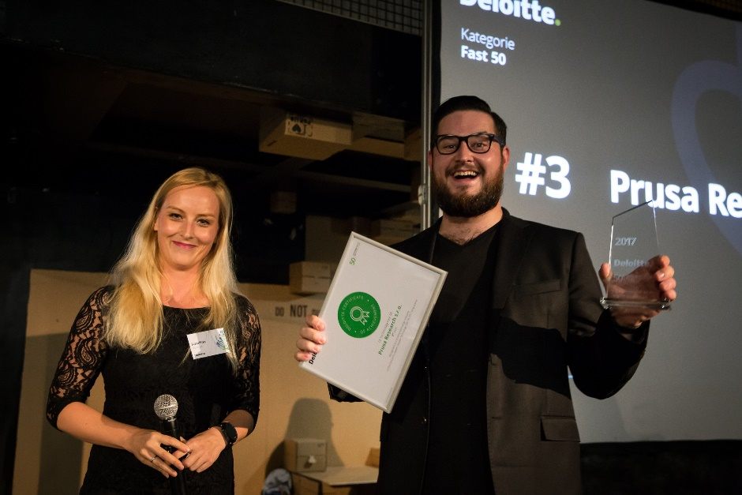
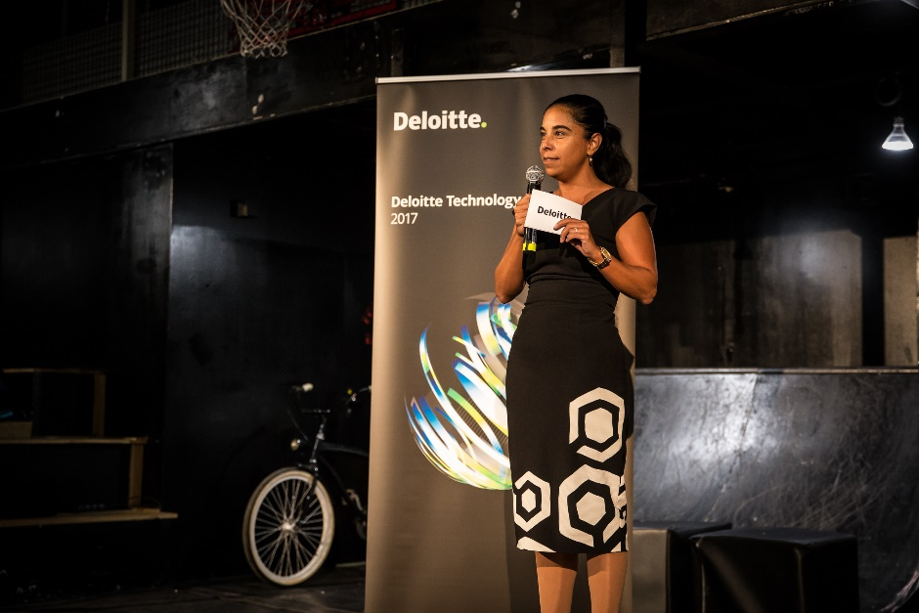
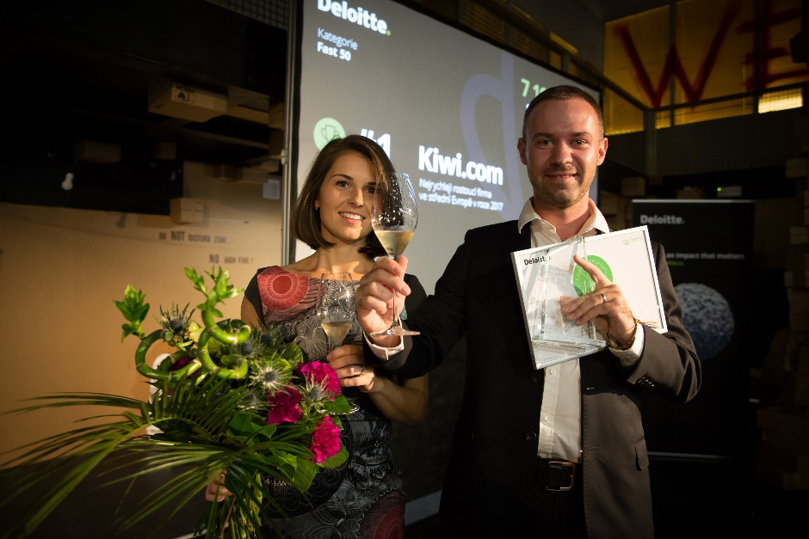
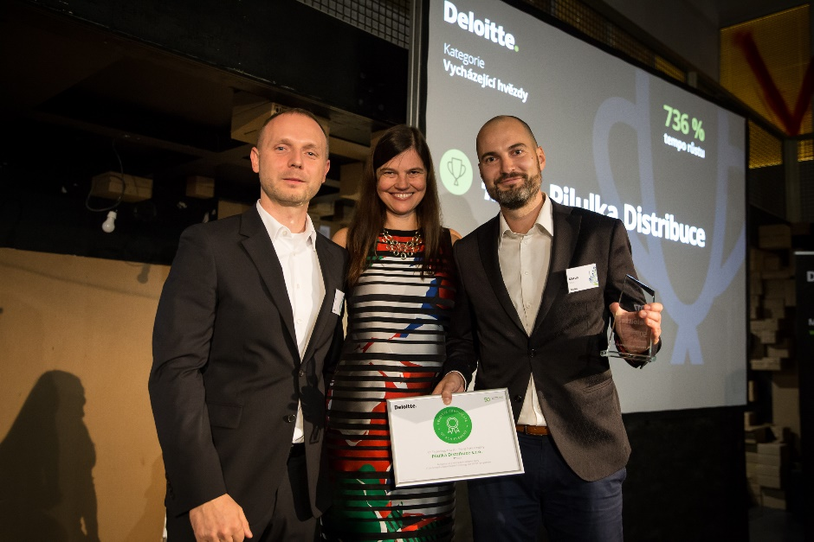
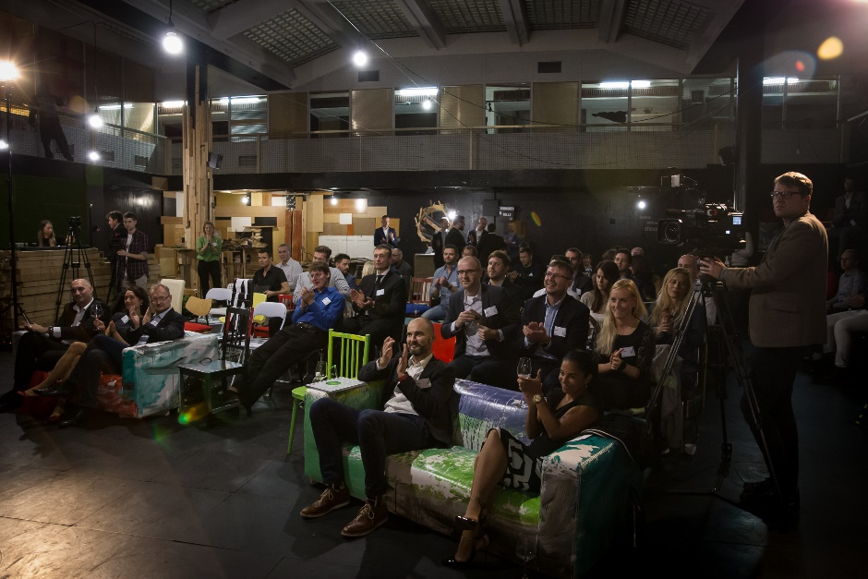
Technology Fast 50 CE
Prague’s Ceremony

Slide 19






Czech team part of Deloitte Global Business Services Eminence Group
Practice: Global Business Services
Central Eminence Team
Tasks of the Central Team
Discuss on current challenges, improving Deloitte marketing / launch initiatives and sharing of eminence plans in the GBS area across markets
Align on eminence activities to avoid overlapping and working together as one global firm
Czech team led by Pavel Šimák became a core member of the Deloitte Global GBS Eminence Team, composed of 6 leading countries
Our clients expect us to know the GBS and SSC market
For more information please reach out to Pavel Šimák

Slide 20

Recent New Wins
Sokolovská uhelná, a.s.
Optimization of energies production and trading
395,000 EUR
+ success fee
Consulting
Martin Čermák, Miroslav Cink

Slide 21
Recent New Wins
ZF Engineering Plzeň s.r.o.
Konica Minolta Business Solutions Czech Republic
140,000 EUR
EUR 130,000
Tax
A. Weber, L. Hanáček, J. Wiederhold, O. Svejkovsky
Tax
L. Hanáček, P. Chytilová,
G. Jansová

Slide 22
Recent New Wins
ELT Management Company
Czech Republic s.r.o.
ELT Management Company
Slovakia s.r.o.
EUR 206,858
200,000 EUR
Legal & Consulting
Legal and Consulting teams led by T. Babáček
Legal & Consulting
Legal and Consulting teams led by T. Babáček

Slide 23

Work opportunity for Senior Consultants
We are looking for a Deloitte Private project coordinator
Currently as a 60% part-time position, full-time going forward
Join us in supporting family and private clients by becoming a coordinator
of a key initiative
What will be your tasks?
  Setting up the process with the management team, coordinating
  the whole project
  Overseeing Key Account Managers for our Deloitte Private clients
  Working with different internal systems, e.g. O2E
  Communicating and working closely with partners across Deloitte
What will you not do without?
A very good grasp of English – experience in project management –
knowledge of Deloitte’s environment – assertiveness – proactive approach
For more information contact vmuckova@deloittece.com

Slide 24
